Slide 1
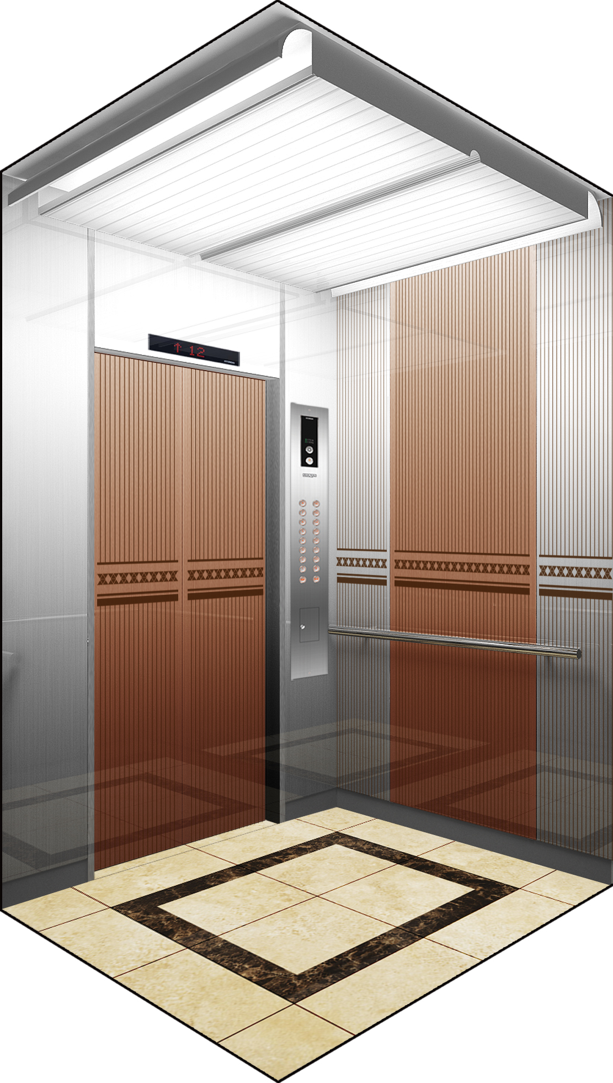
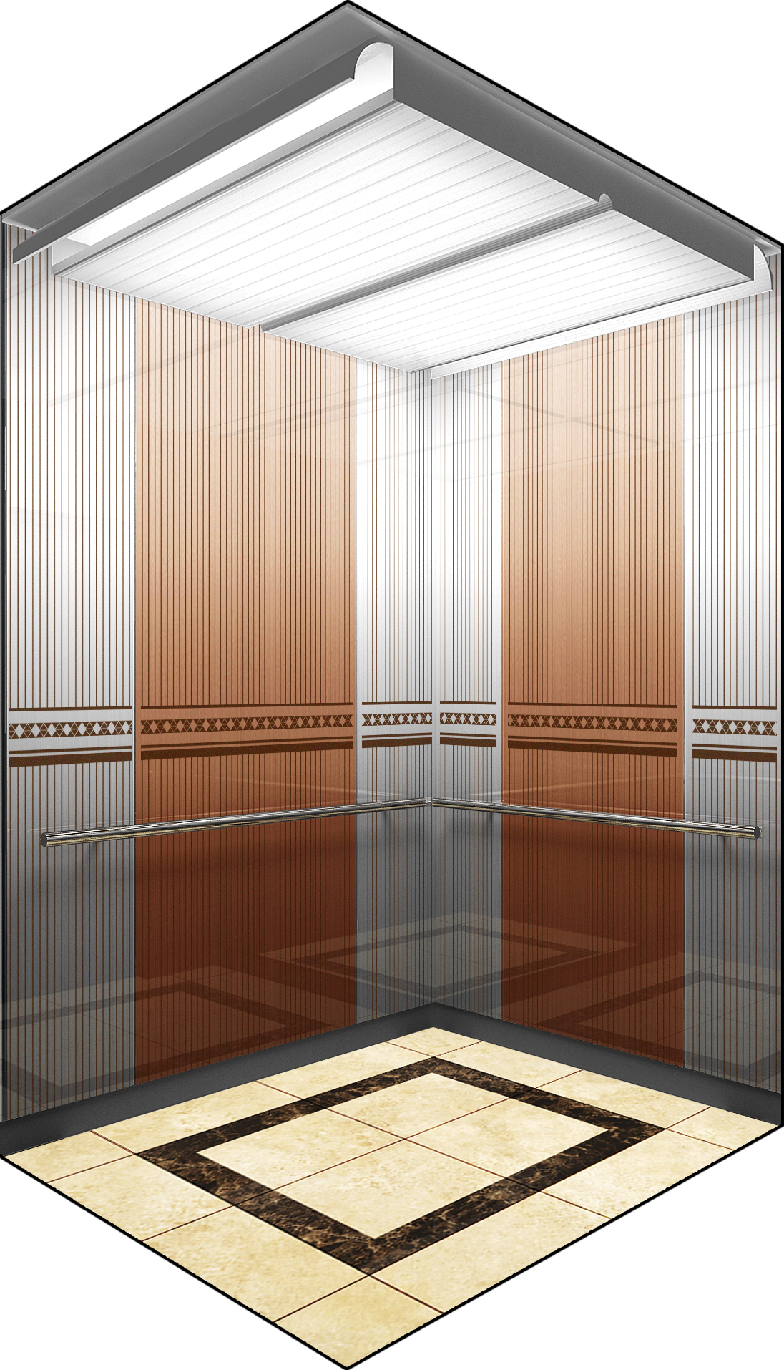
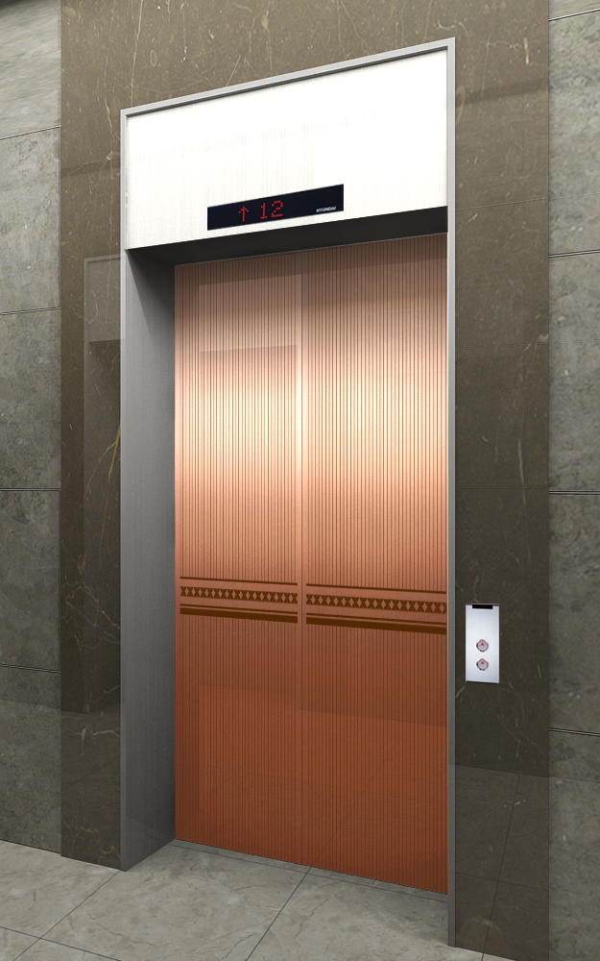
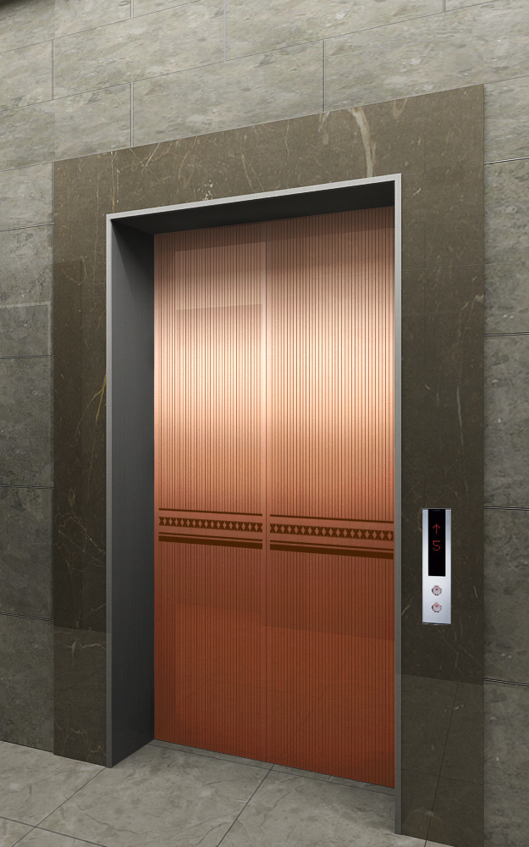
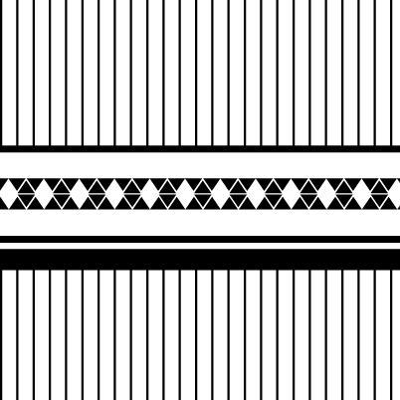
NEO SHINE METAL Elevator Interior Design
ALT-1
MAIN ENTRANCE
OTHER ENTRANCE
Front View
Rear View
1.
CEILING
DOOR
WALL
HANDRAIL
FLOORING
INDICATOR
OPB
COLUMN & 상판
ELC2-014
Neo Shine Metal(BZ/ 804)
Neo Shine Metal(BZ/ 804, CL/804)
1B
인조 대리석
PI-D110
OPP-N241B
STS Hairline
MAIN DOOR
막판
삼방틀
INDICATOR
HALL BUTTON
OTHER DOOR
막판
삼방틀
HALL BUTTON
Neo Shine Metal(BZ/ 804)
STS Hairline
STS Hairline(200Type)
PI-D110(DOT TYPE)
HPB-841(노출형)
Neo Shine Metal(BZ/ 804)
STS Hairline
STS Hairline(100Type)
HIP-D841(노출형)
1. Neo Shine Metal(BZ/ 804)
2. Neo Shine Metal(CL/ 804)

Slide 2
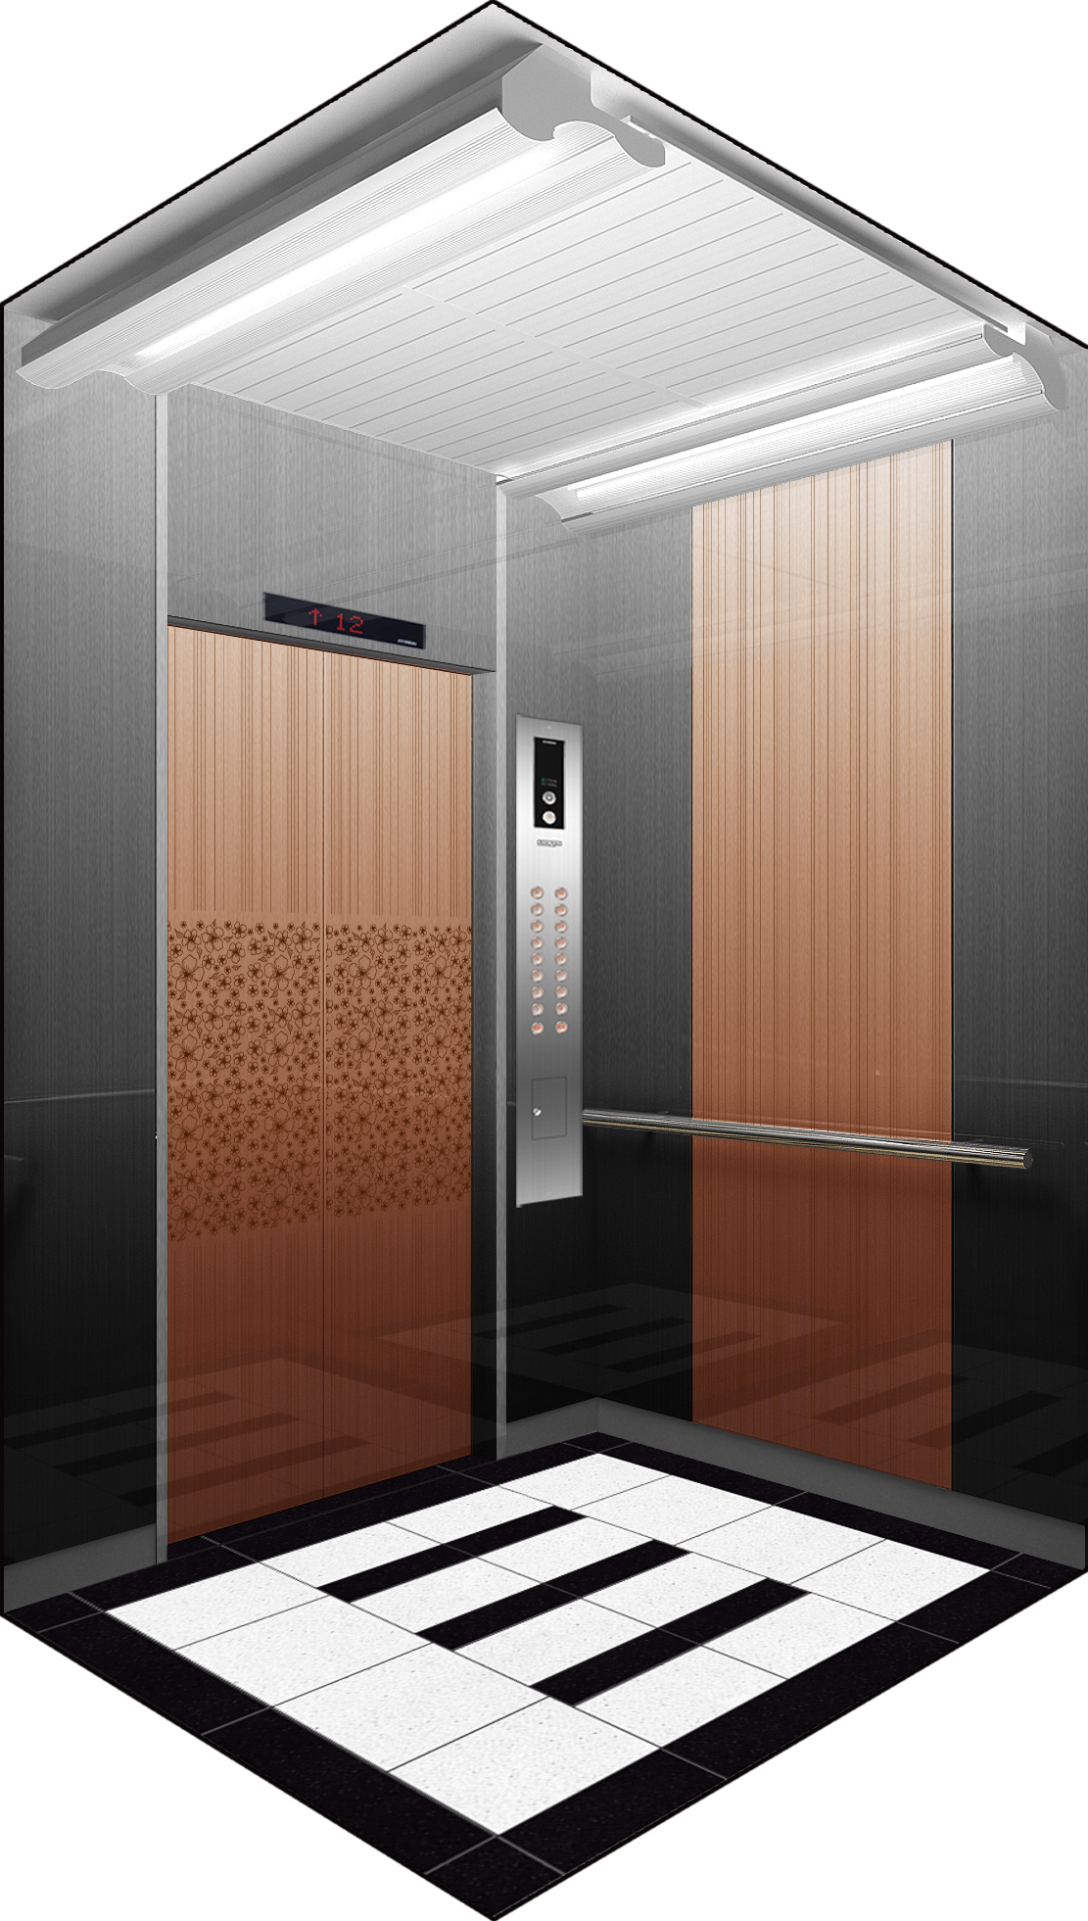
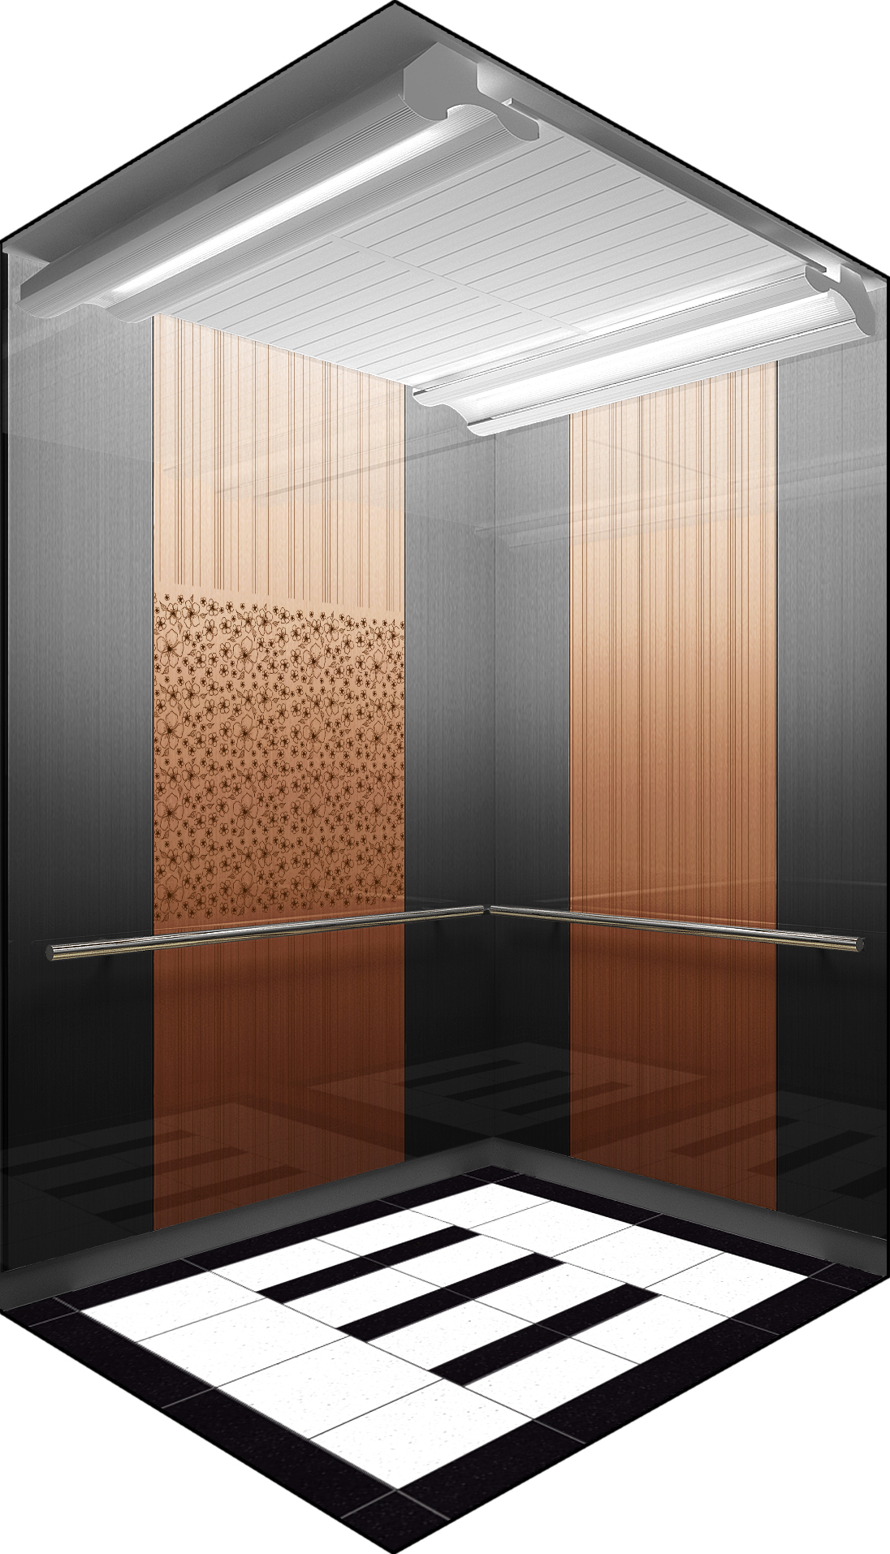
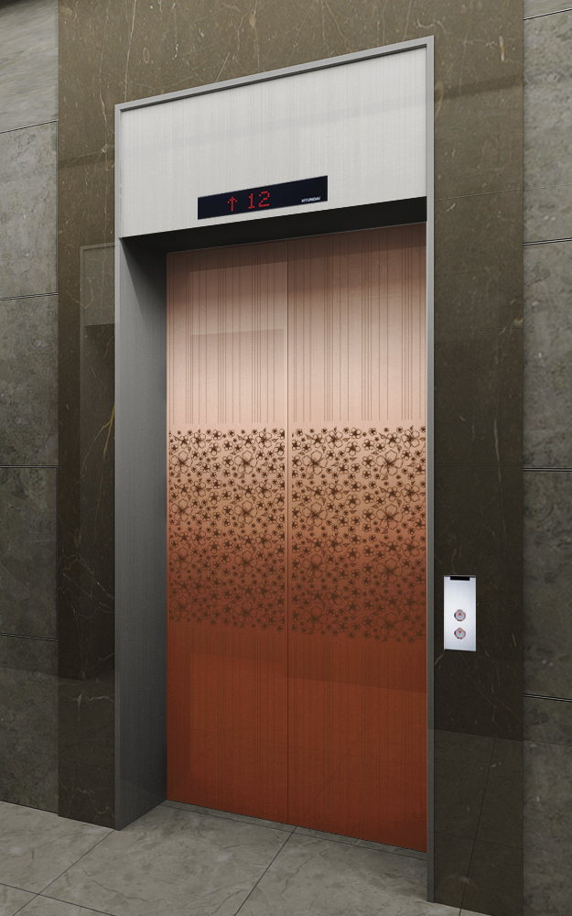
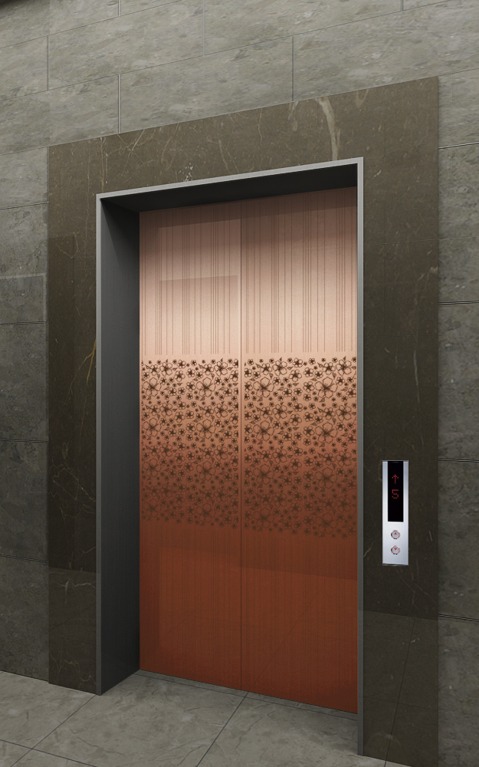
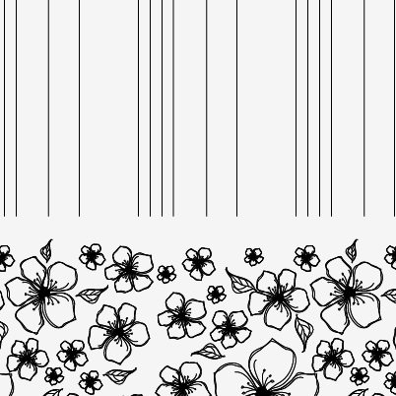
NEO SHINE METAL Elevator Interior Design
ALT-2
MAIN ENTRANCE
OTHER ENTRANCE
Front View
Rear View
1.
CEILING
DOOR
WALL
HANDRAIL
FLOORING
INDICATOR
OPB
COLUMN & 상판
ELC2-012
Neo Shine Metal(BZ/ 804)
Neo Shine Metal(BZ/ 804, BK)
1B
Deco Tile
PI-D110
OPP-N241B
STS Hairline
MAIN DOOR
막판
삼방틀
INDICATOR
HALL BUTTON
OTHER DOOR
막판
삼방틀
HALL BUTTON
Neo Shine Metal(BZ/ 804)
STS Hairline
STS Hairline(200Type)
PI-D110(DOT TYPE)
HPB-841(노출형)
Neo Shine Metal(BZ/ 804)
STS Hairline
STS Hairline(100Type)
HIP-D841(노출형)
1. Neo Shine Metal(BZ/ 804)

Slide 3
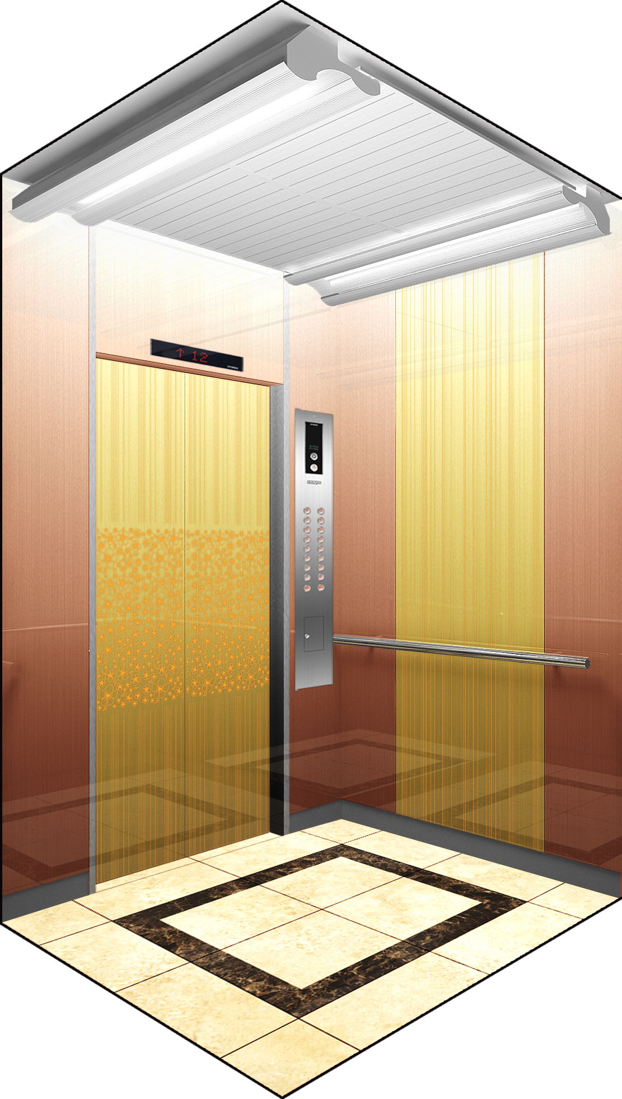
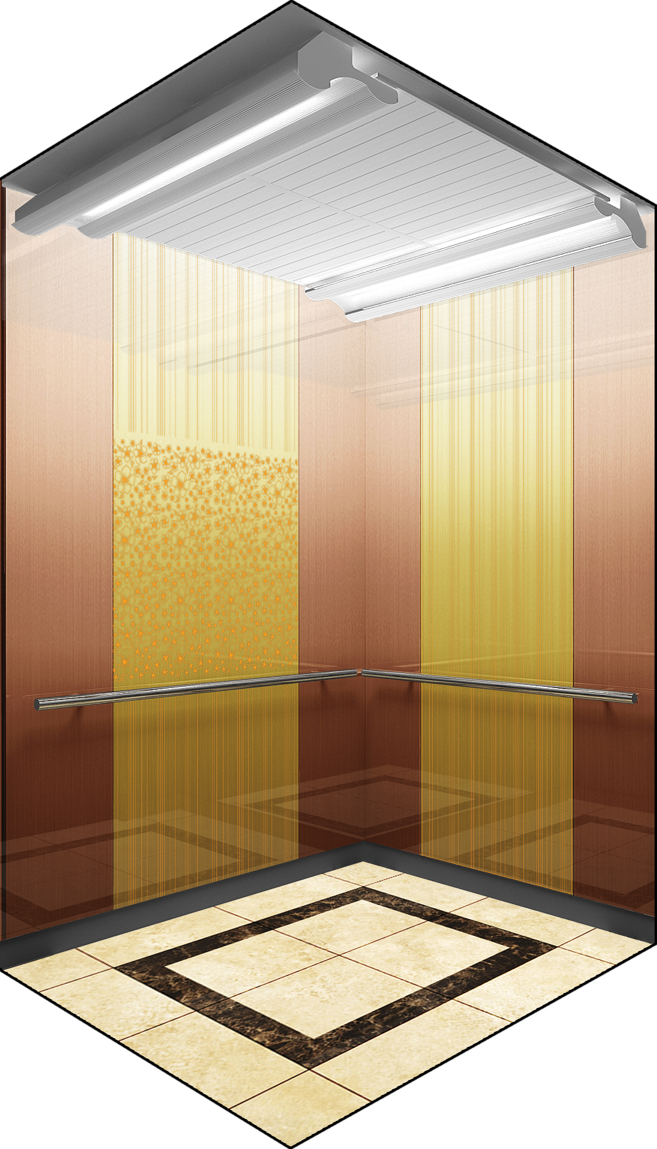
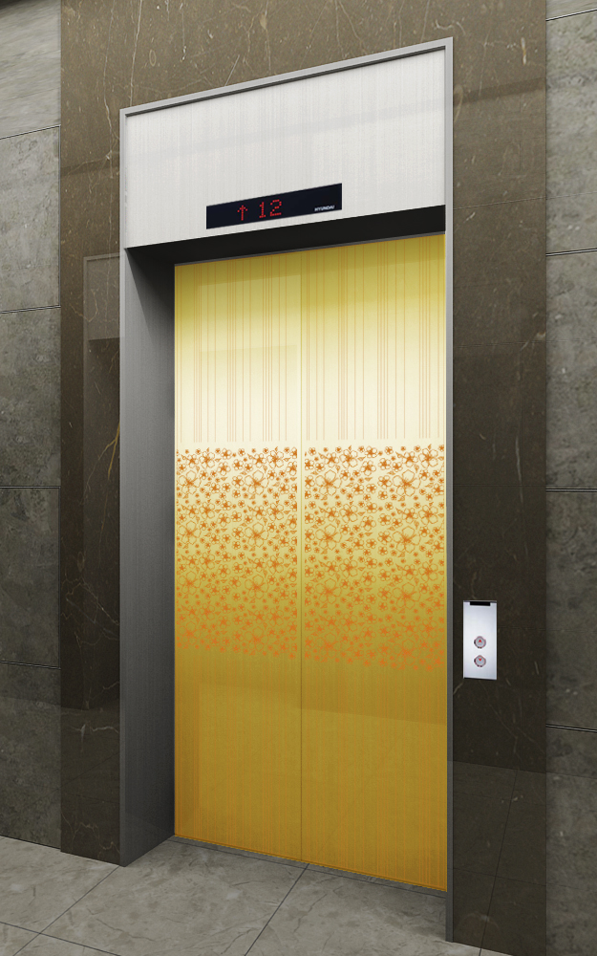
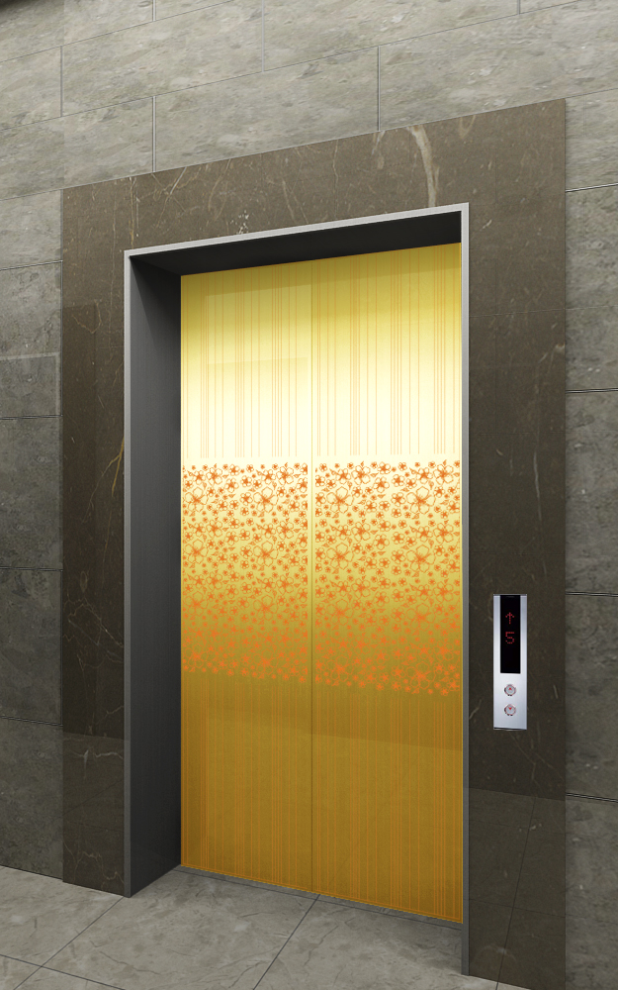
NEO SHINE METAL Elevator Interior Design
ALT-3
MAIN ENTRANCE
OTHER ENTRANCE
Front View
Rear View
1.
CEILING
DOOR
WALL
HANDRAIL
FLOORING
INDICATOR
OPB
COLUMN & 상판
ELC2-012
Neo Shine Metal(GD/ 802)
Neo Shine Metal(GD/ 802, BZ)
1B
인조 대리석
PI-D110
OPP-N241B
STS Hairline
MAIN DOOR
막판
삼방틀
INDICATOR
HALL BUTTON
OTHER DOOR
막판
삼방틀
HALL BUTTON
Neo Shine Metal(GD/802)
STS Hairline
STS Hairline(200Type)
PI-D110(DOT TYPE)
HPB-841(노출형)
Neo Shine Metal(GD/802)
STS Hairline
STS Hairline(100Type)
HIP-D841(노출형)
1. Neo Shine Metal(GD/802)

Slide 4
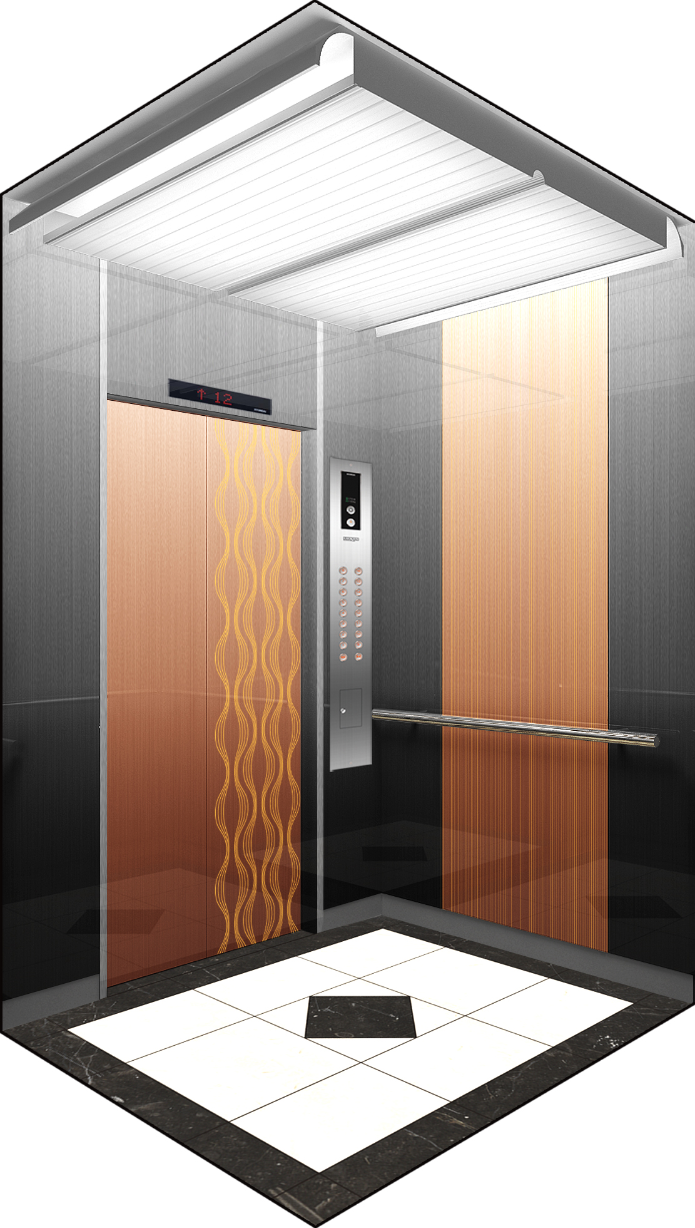
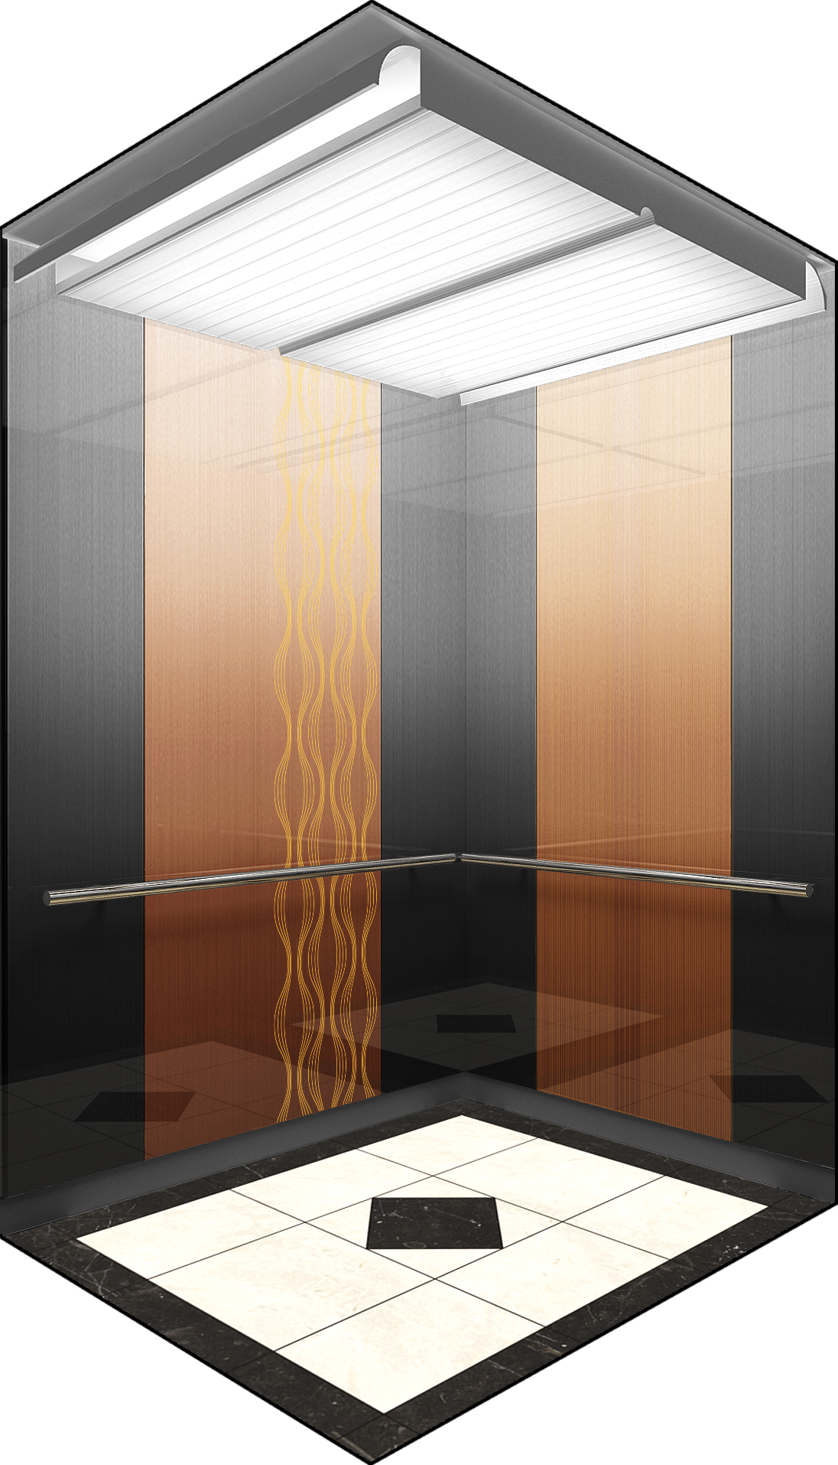
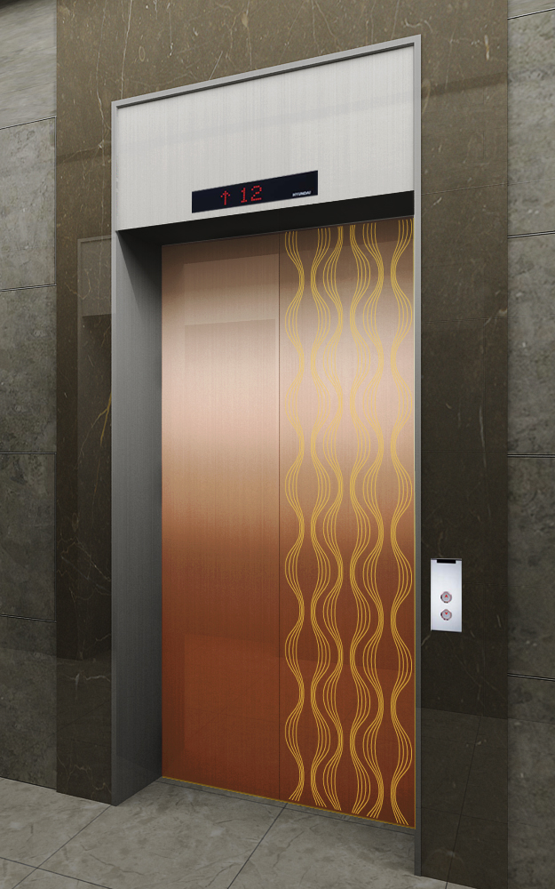
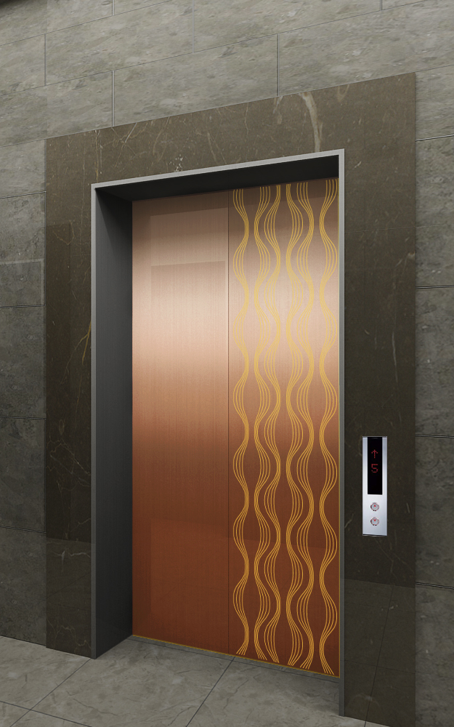
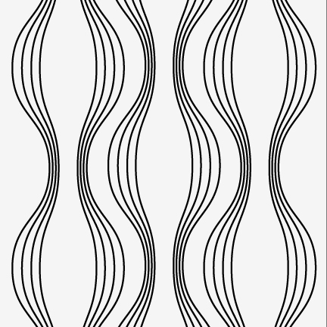
NEO SHINE METAL Elevator Interior Design
ALT-4
MAIN ENTRANCE
OTHER ENTRANCE
Front View
Rear View
2.
1.
CEILING
DOOR
WALL
HANDRAIL
FLOORING
INDICATOR
OPB
COLUMN & 상판
ELC2-014
Neo Shine Metal(BZ/830)
Neo Shine Metal(BZ/ 830, BK)
1B
Deco Tile
PI-D110
OPP-N241B
STS Hairline
MAIN DOOR
막판
삼방틀
INDICATOR
HALL BUTTON
OTHER DOOR
막판
삼방틀
HALL BUTTON
Neo Shine Metal(BZ/ 830)
STS Hairline
STS Hairline(200Type)
PI-D110(DOT TYPE)
HPB-841(노출형)
Neo Shine Metal(BZ/ 830)
STS Hairline
STS Hairline(100Type)
HIP-D841(노출형)
1. Neo Shine Metal(BZ/ 830)
2. Neo Shine Metal(BZ/ 830)

Slide 5
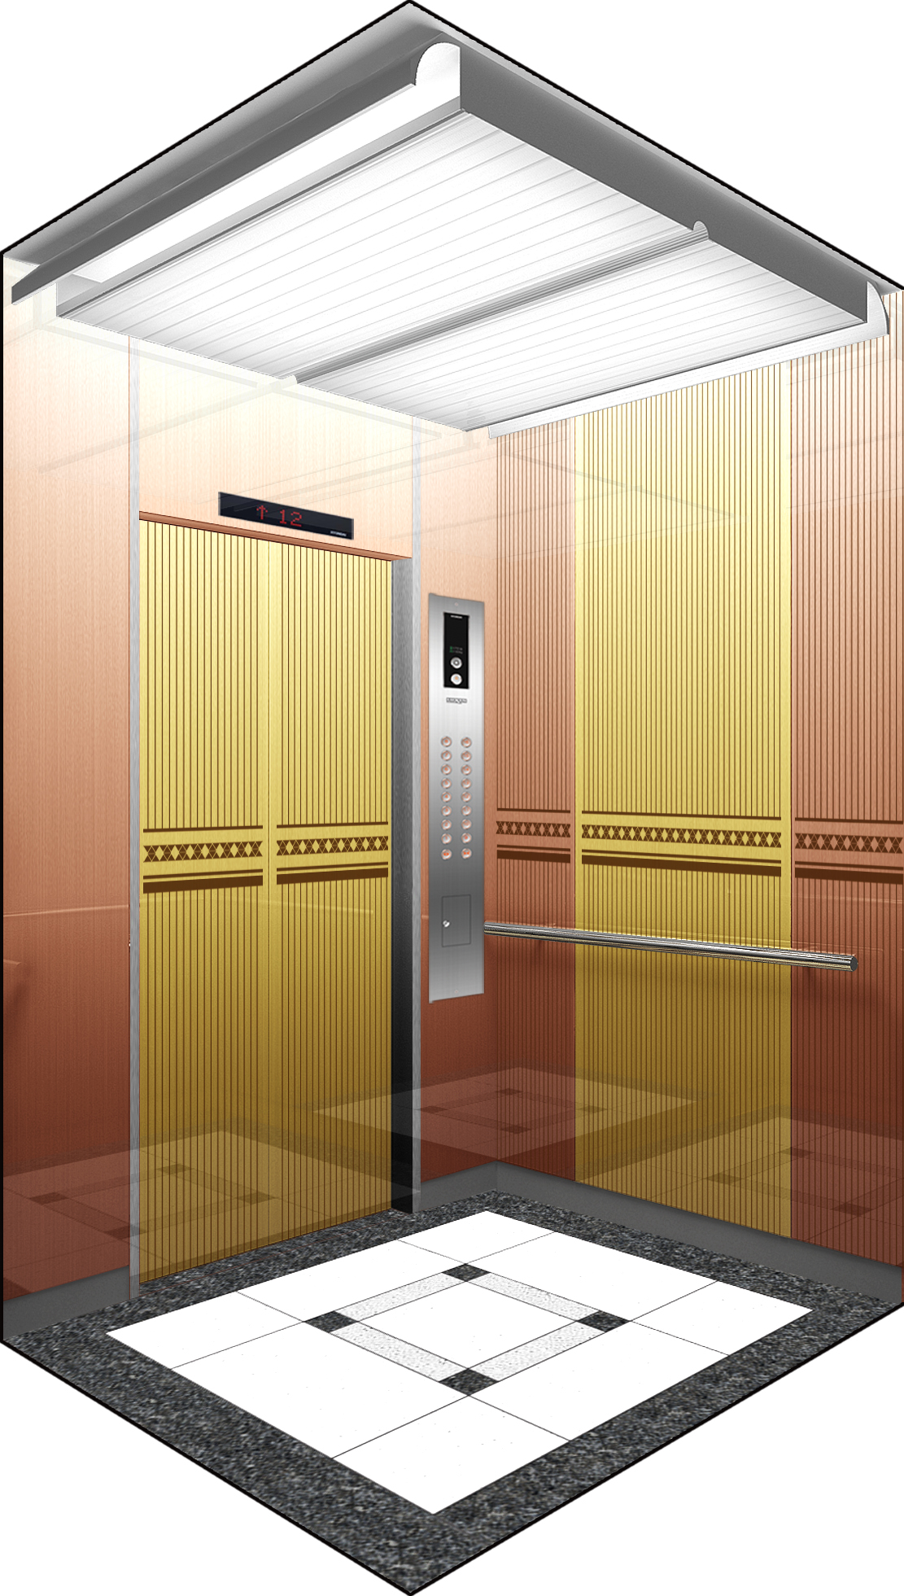
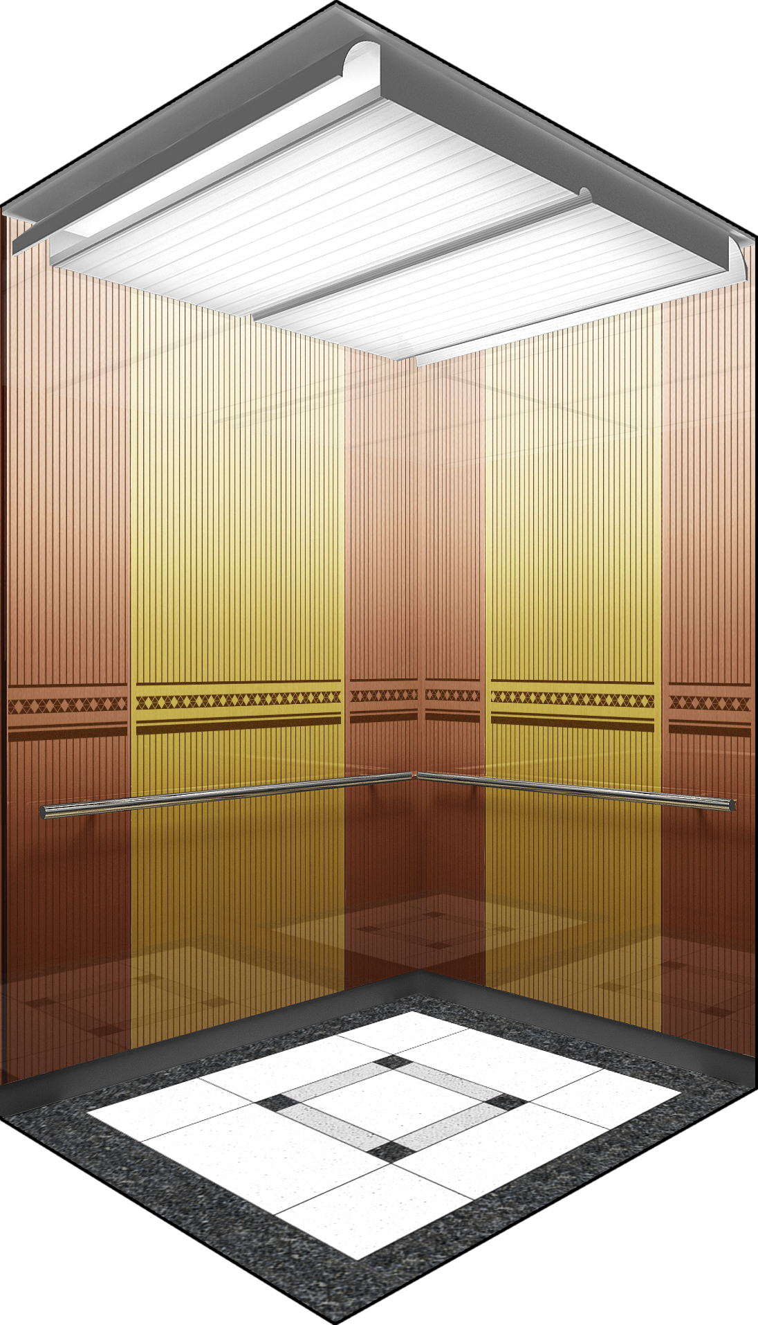
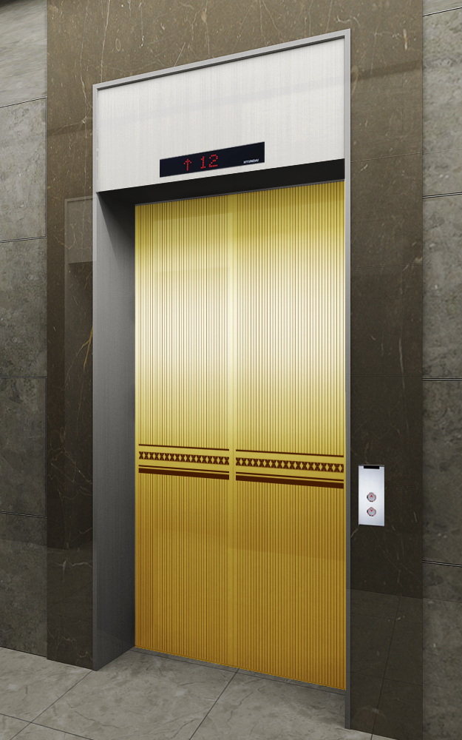
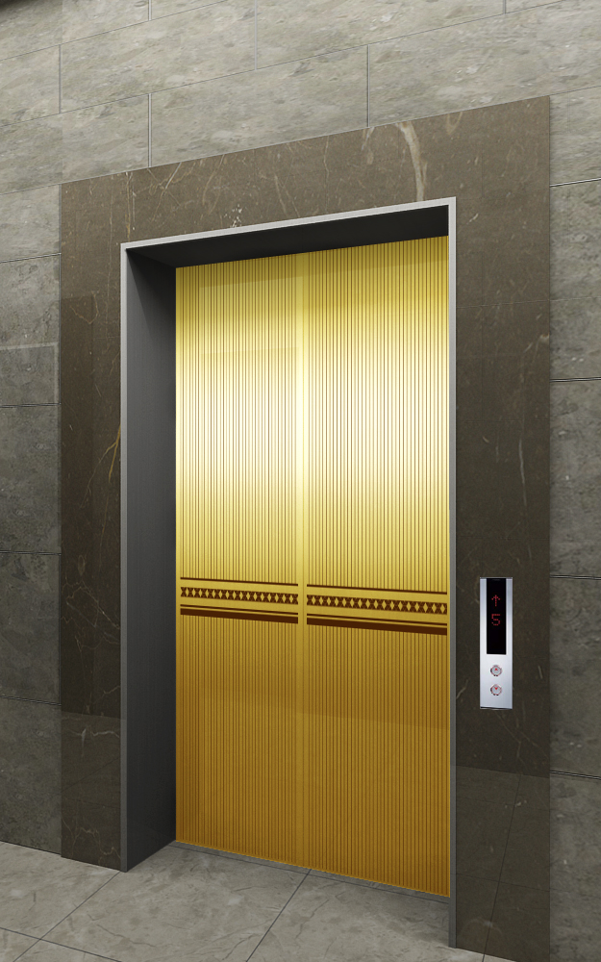
NEO SHINE METAL Elevator Interior Design
ALT-5
MAIN ENTRANCE
OTHER ENTRANCE
Front View
Rear View
1.
CEILING
DOOR
WALL
HANDRAIL
FLOORING
INDICATOR
OPB
COLUMN & 상판
ELC0-014
Neo Shine Metal(GD/804))
Neo Shine Metal(GD/804, BZ/804)
1B
인조 대리석
PI-D110
OPP-N241B
STS Hairline
MAIN DOOR
막판
삼방틀
INDICATOR
HALL BUTTON
OTHER DOOR
막판
삼방틀
HALL BUTTON
Neo Shine Metal(GD/804)
STS Hairline
STS Hairline(200Type)
PI-D110(DOT TYPE)
HPB-841(노출형)
Neo Shine Metal(GD/804)
STS Hairline
STS Hairline(100Type)
HIP-D841(노출형)
1. Neo Shine Metal(GD/804)
2. Neo Shine Metal(BZ/804)

Slide 6
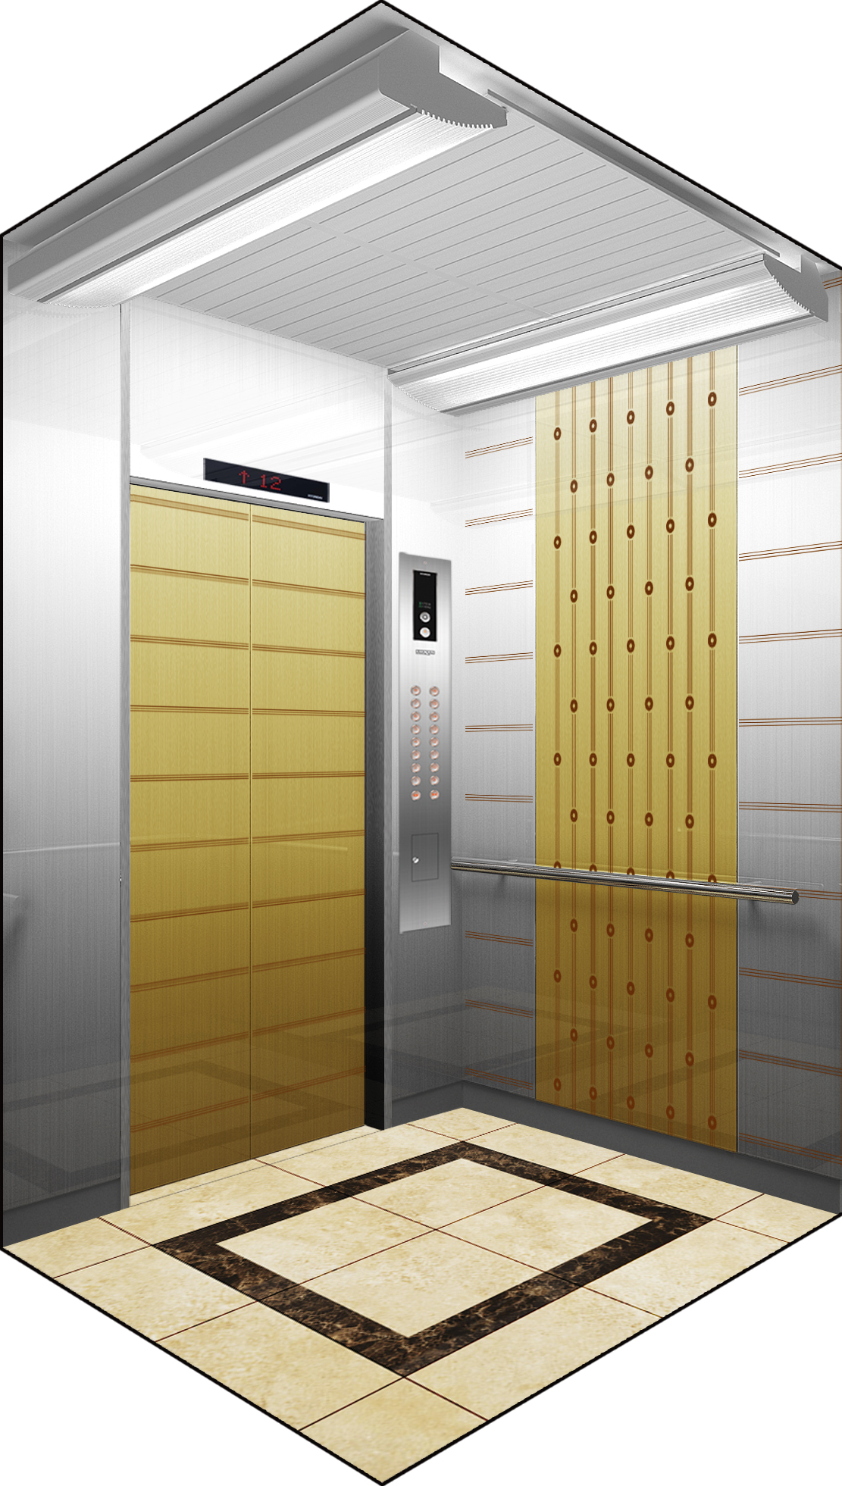
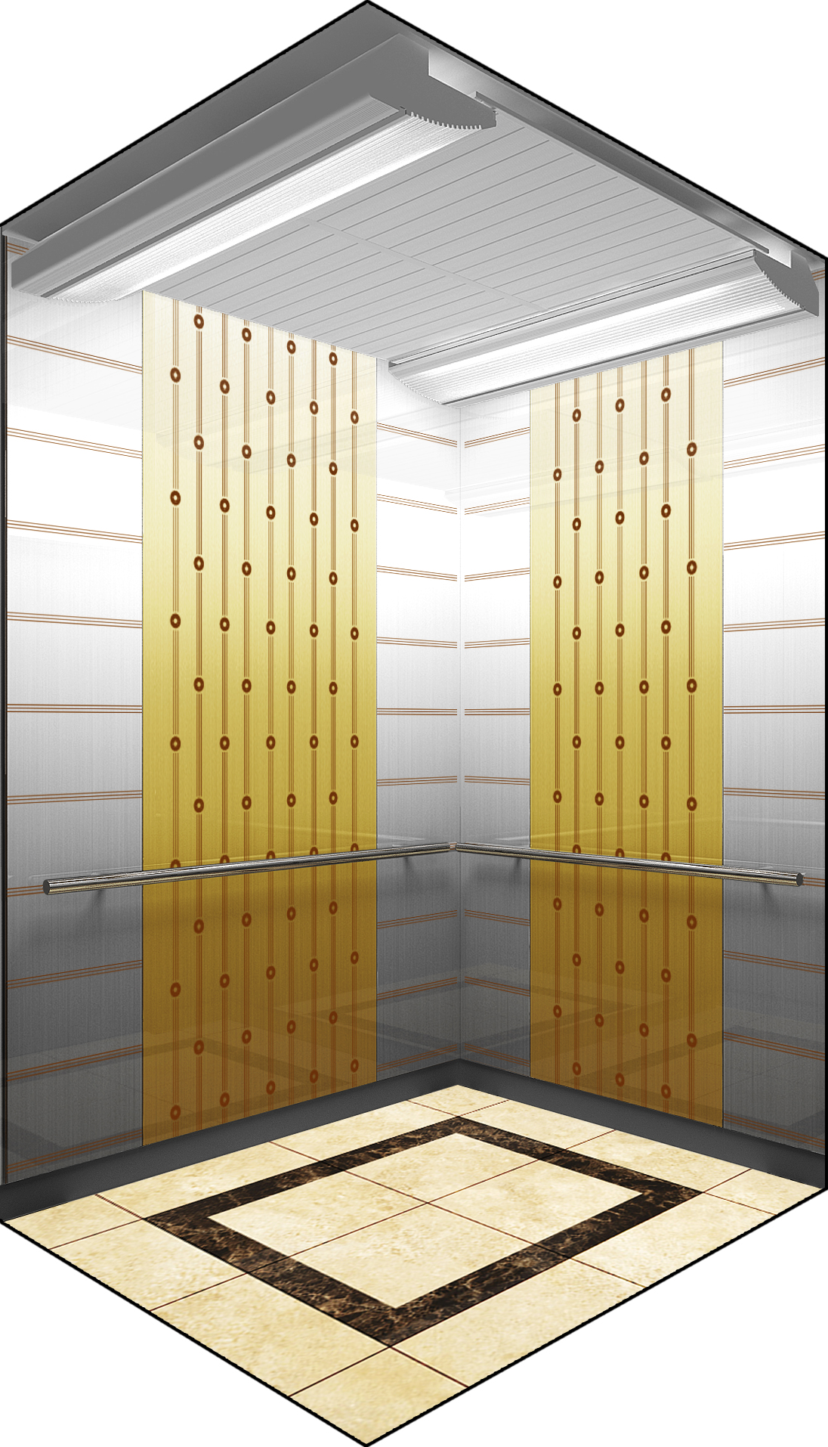
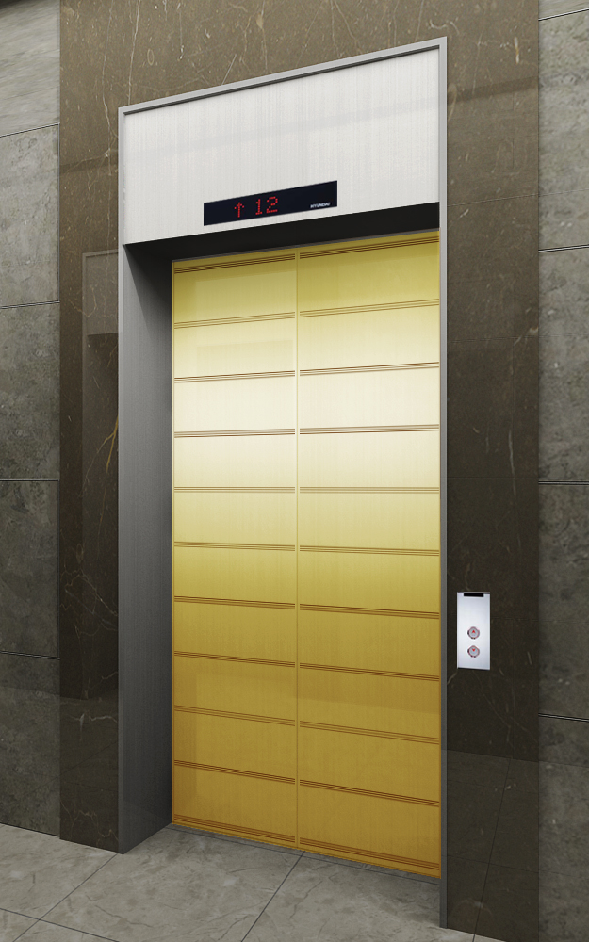
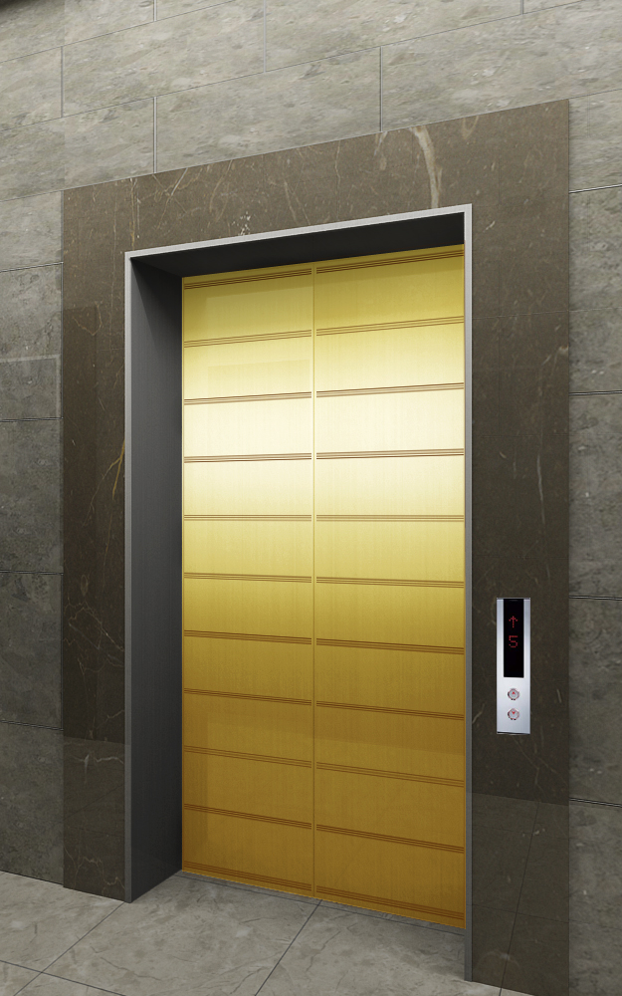
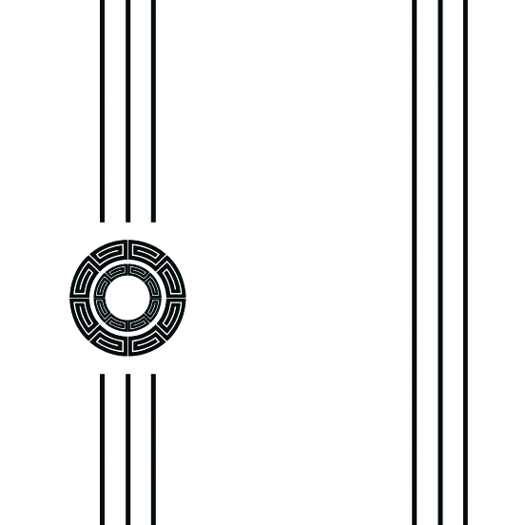
NEO SHINE METAL Elevator Interior Design
ALT-6
MAIN ENTRANCE
OTHER ENTRANCE
Front View
Rear View
2.
1.
CEILING
DOOR
WALL
HANDRAIL
FLOORING
INDICATOR
OPB
COLUMN & 상판
ELC2-011
Neo Shine Metal(GD/ 804)
Neo Shine Metal(GD/804, CL/804)
1B
인조 대리석
PI-D110
OPP-N241B
STS Hairline
MAIN DOOR
막판
삼방틀
INDICATOR
HALL BUTTON
OTHER DOOR
막판
삼방틀
HALL BUTTON
Neo Shine Metal(GD/804)
STS Hairline
STS Hairline(200Type)
PI-D110(DOT TYPE)
HPB-841(노출형)
Neo Shine Metal(GD/804)
STS Hairline
STS Hairline(100Type)
HIP-D841(노출형)
1. Neo Shine Metal(GD/804)
2. Neo Shine Metal(CL/804, GD/804)

Slide 7
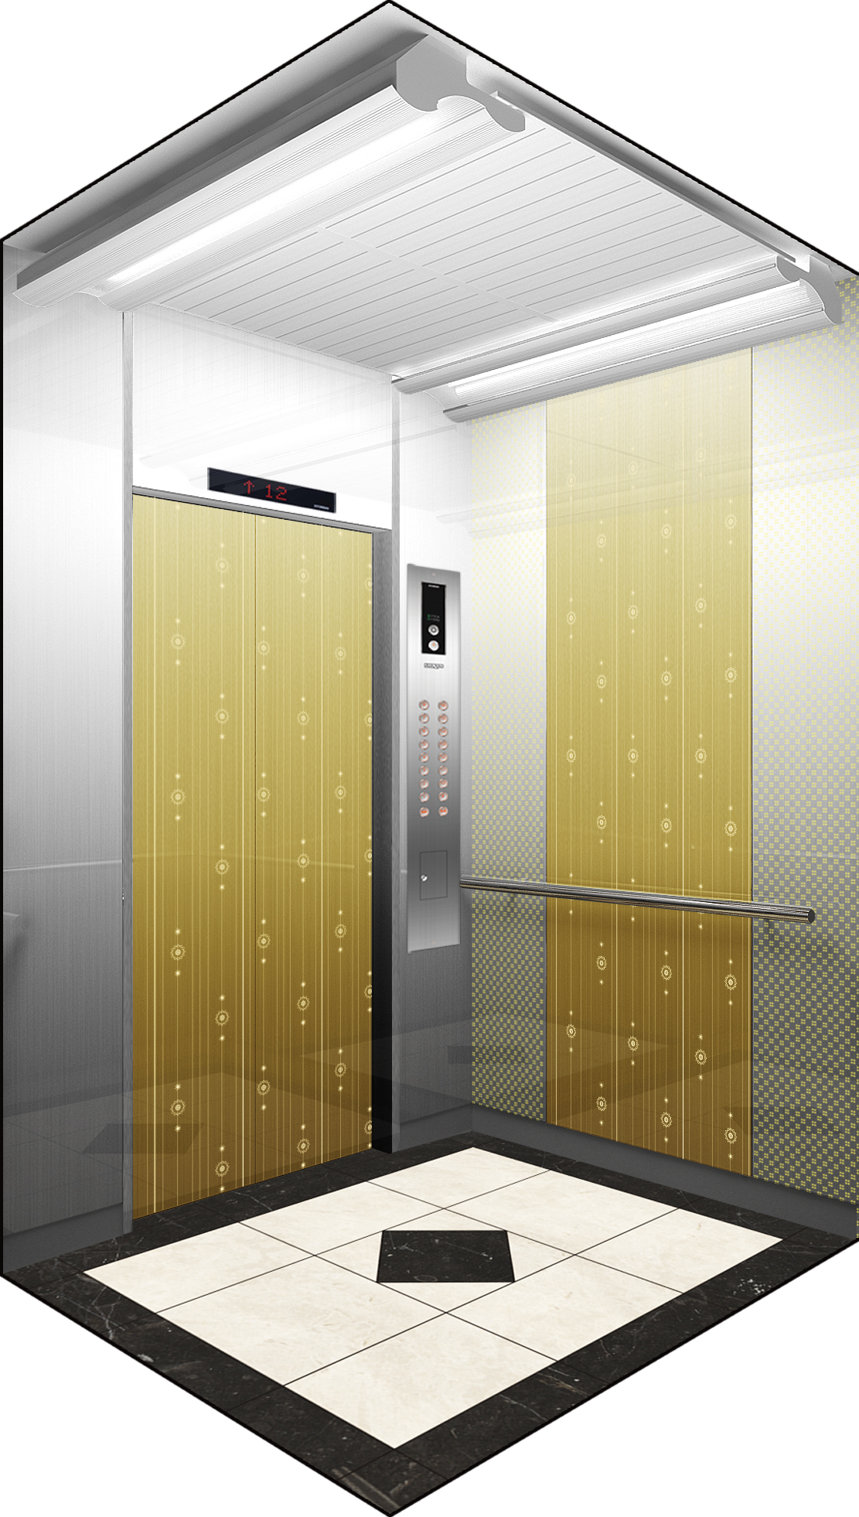
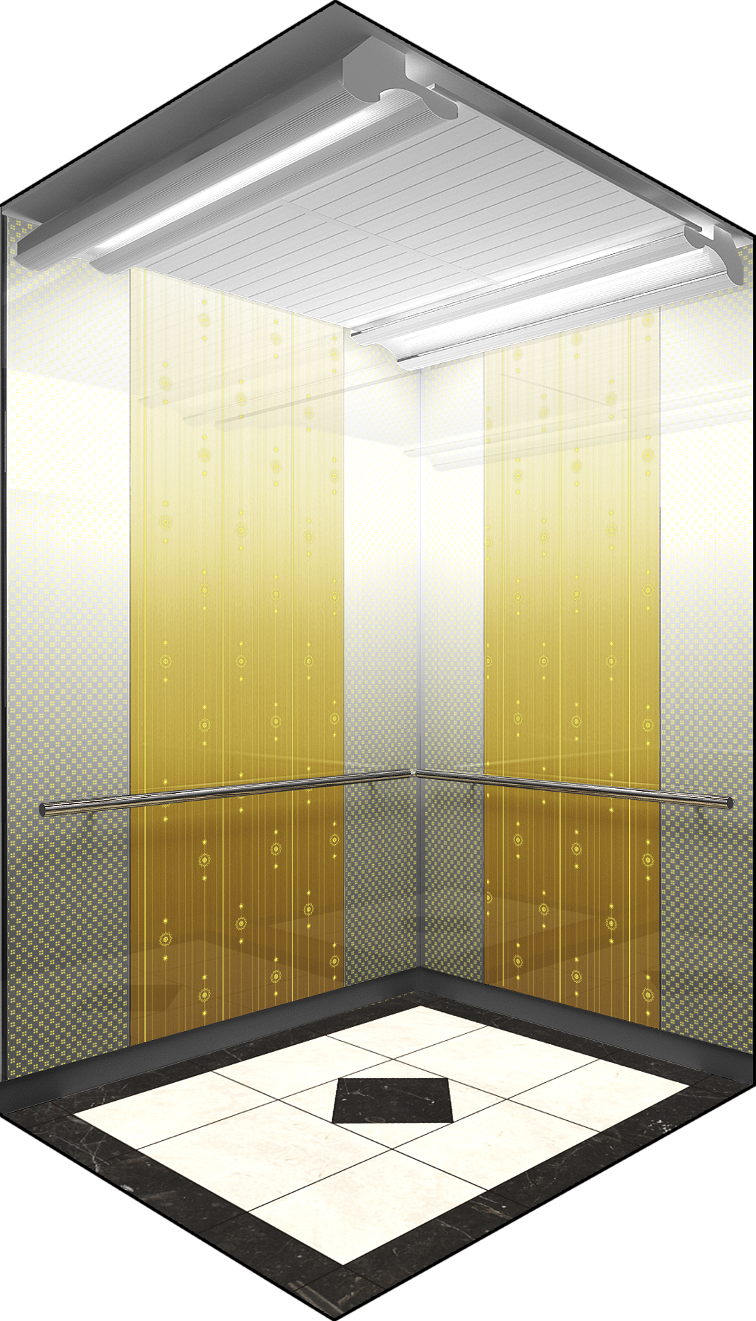
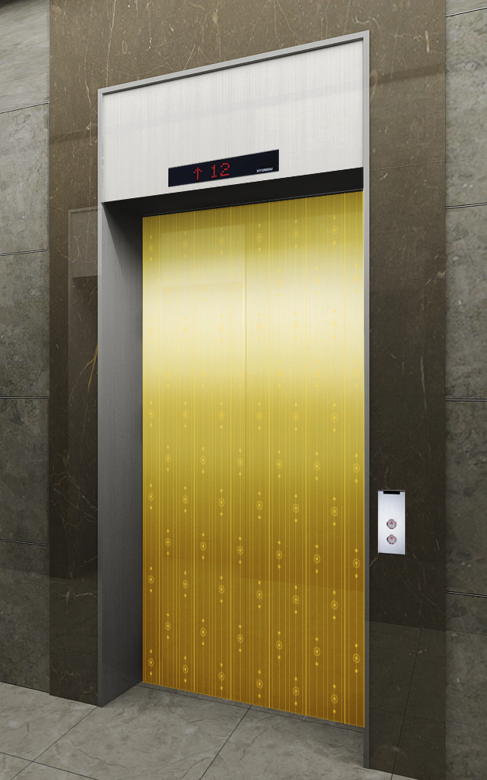
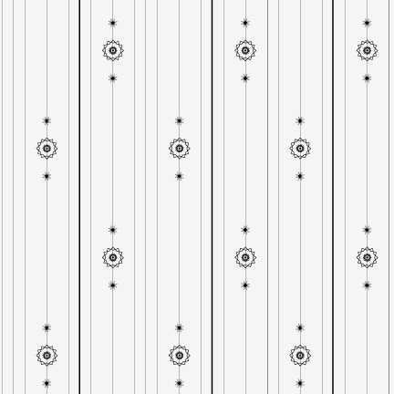
NEO SHINE METAL Elevator Interior Design
ALT-7
MAIN ENTRANCE
OTHER ENTRANCE
Front View
Rear View
2.
1.
CEILING
DOOR
WALL
HANDRAIL
FLOORING
INDICATOR
OPB
COLUMN & 상판
ELC2-012
Neo Shine Metal(GD/830)
Neo Shine Metal(GD/830, CL/830)
1B
Deco Tile
PI-D110
OPP-N241B
STS Hairline
MAIN DOOR
막판
삼방틀
INDICATOR
HALL BUTTON
OTHER DOOR
막판
삼방틀
HALL BUTTON
Neo Shine Metal(GD/830)
STS Hairline
STS Hairline(200Type)
PI-D110(DOT TYPE)
HPB-841(노출형)
Neo Shine Metal(GD/830)
STS Hairline
STS Hairline(100Type)
HIP-D841(노출형)
1. Neo Shine Metal(GD/ 830)
2. Neo Shine Metal(CL/830)

Slide 8
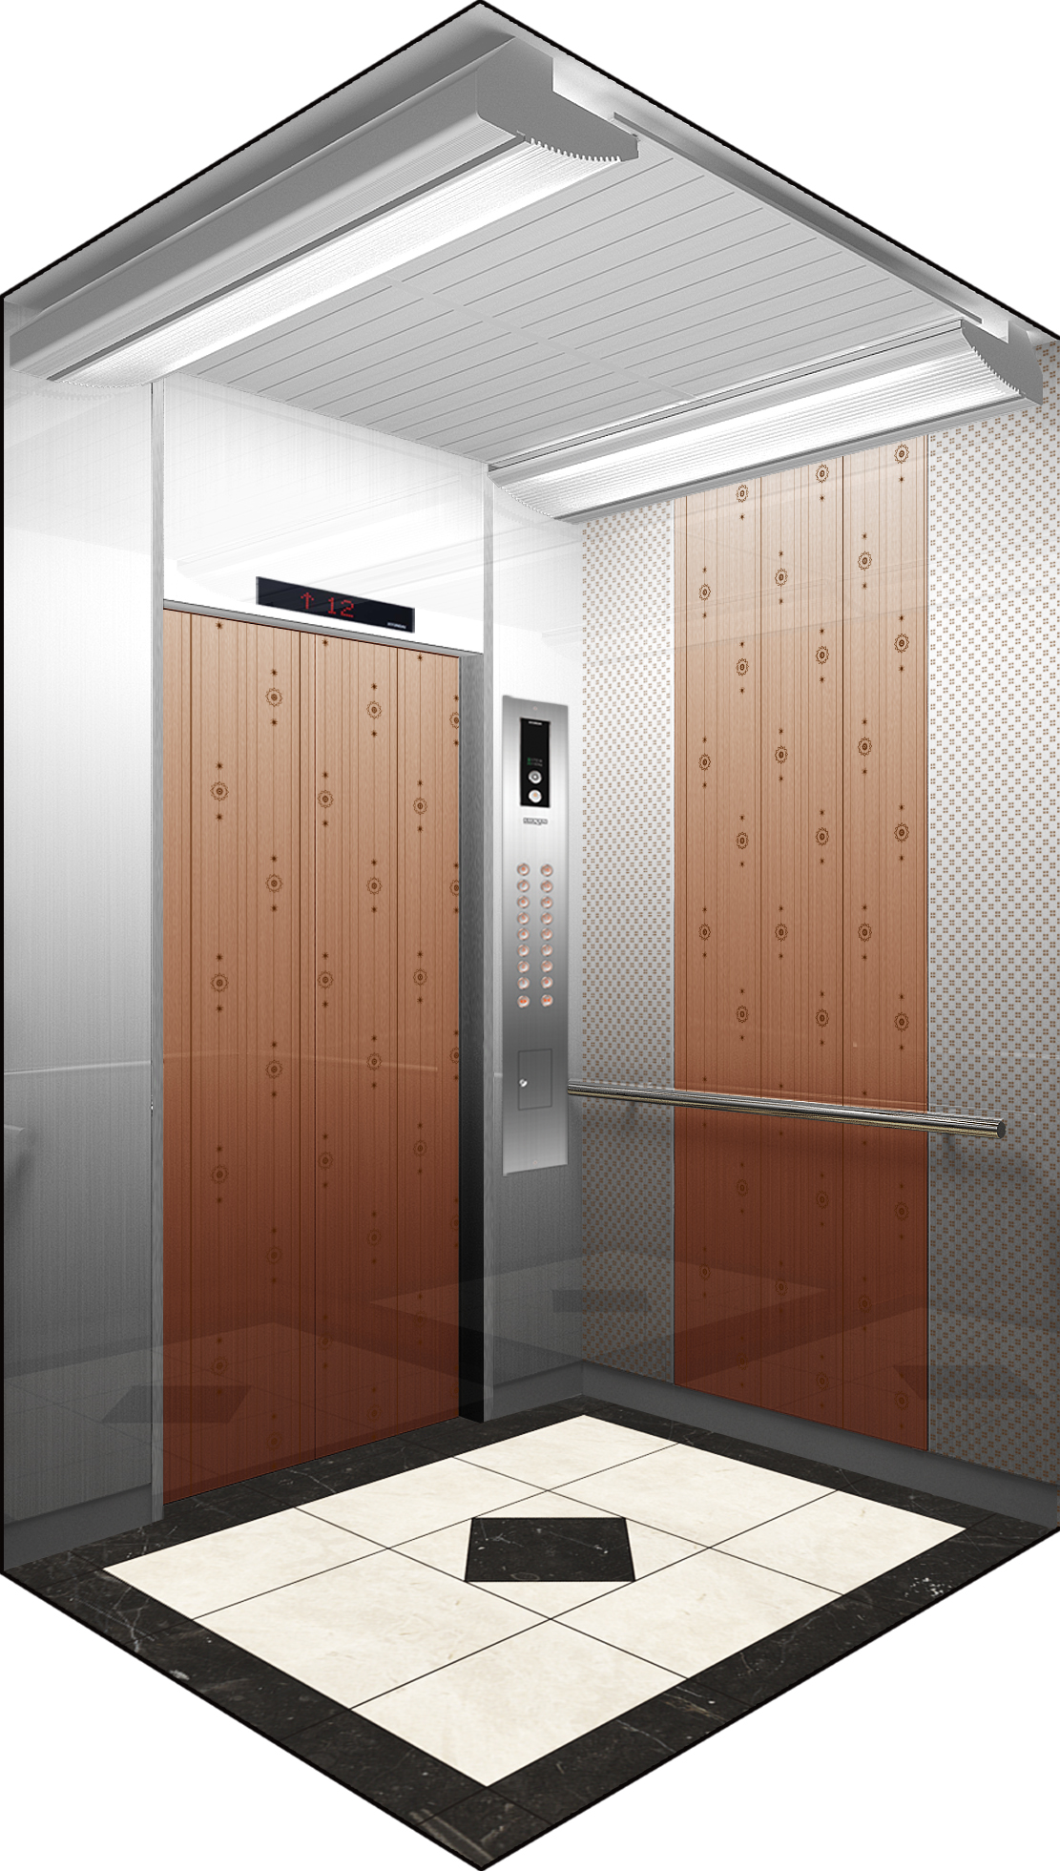
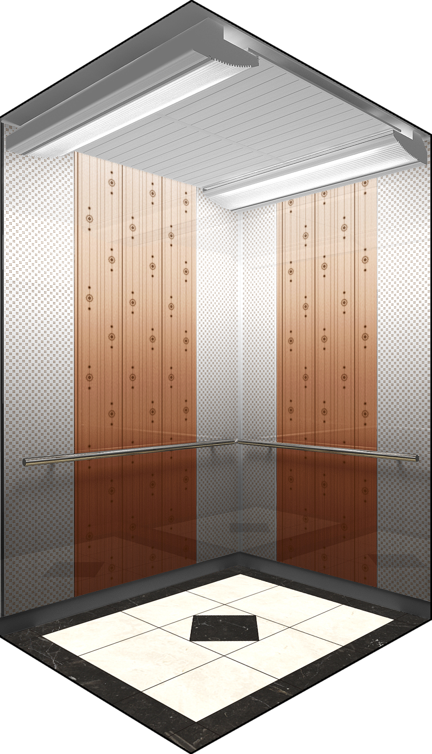
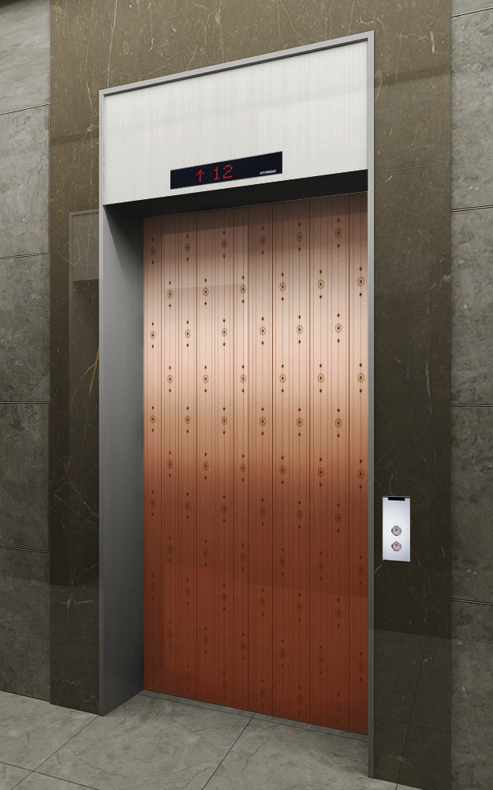
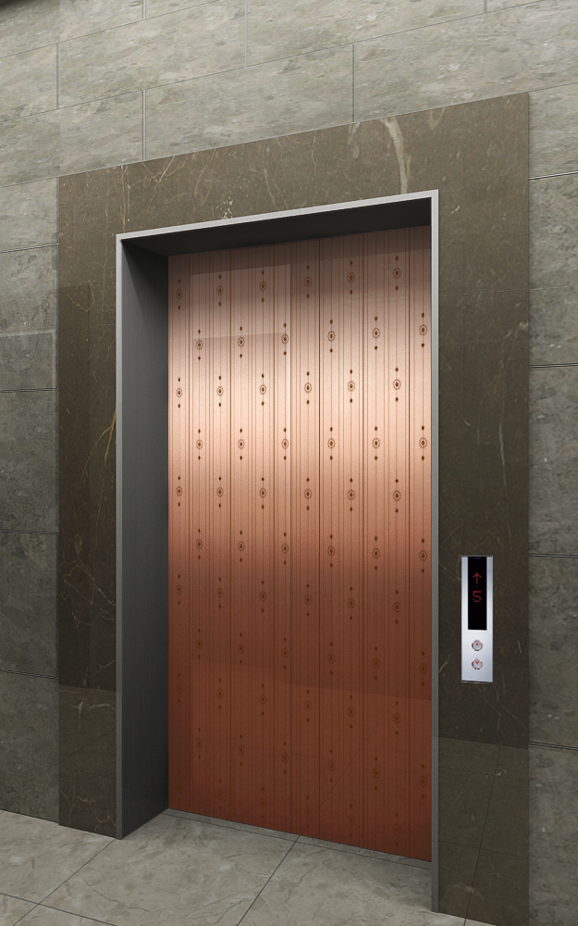
NEO SHINE METAL Elevator Interior Design
ALT-8
MAIN ENTRANCE
OTHER ENTRANCE
Front View
Rear View
2.
1.
CEILING
DOOR
WALL
HANDRAIL
FLOORING
INDICATOR
OPB
COLUMN & 상판
ELC2-011
Neo Shine Metal(BZ/ 804)
Neo Shine Metal(BZ/ 804, CL/804)
1B
Deco Tile
PI-D110
OPP-N241B
STS Hairline
MAIN DOOR
막판
삼방틀
INDICATOR
HALL BUTTON
OTHER DOOR
막판
삼방틀
HALL BUTTON
Neo Shine Metal(BZ/ 804)
STS Hairline
STS Hairline(200Type)
PI-D110(DOT TYPE)
HPB-841(노출형)
Neo Shine Metal(BZ/ 804)
STS Hairline
STS Hairline(100Type)
HIP-D841(노출형)
1. Neo Shine Metal(BZ/ 804)
2. Neo Shine Metal(CL/804)

Slide 9
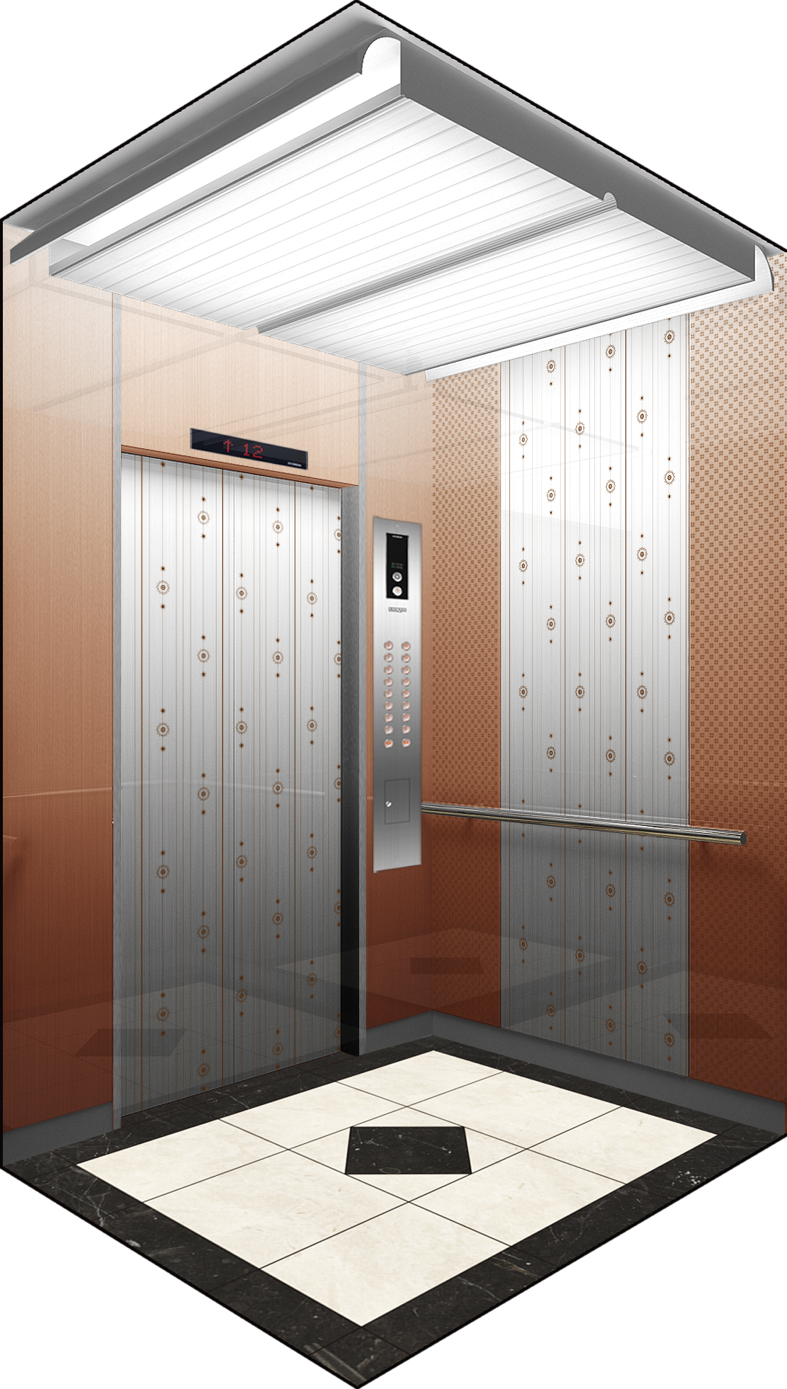
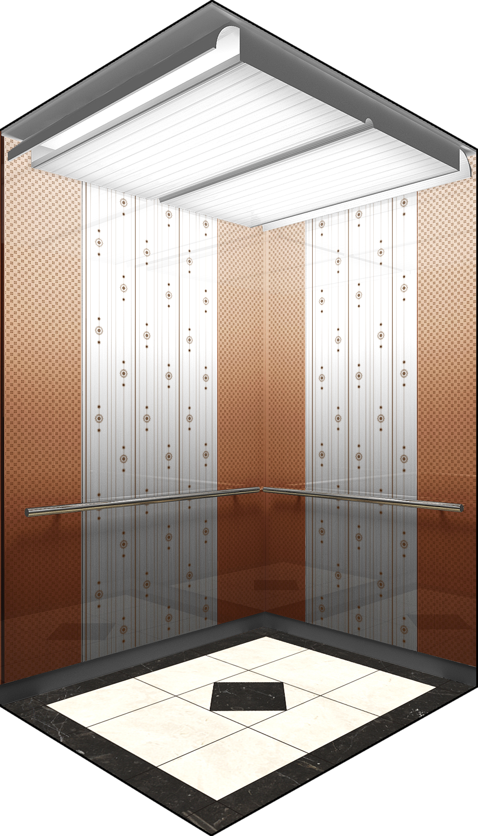
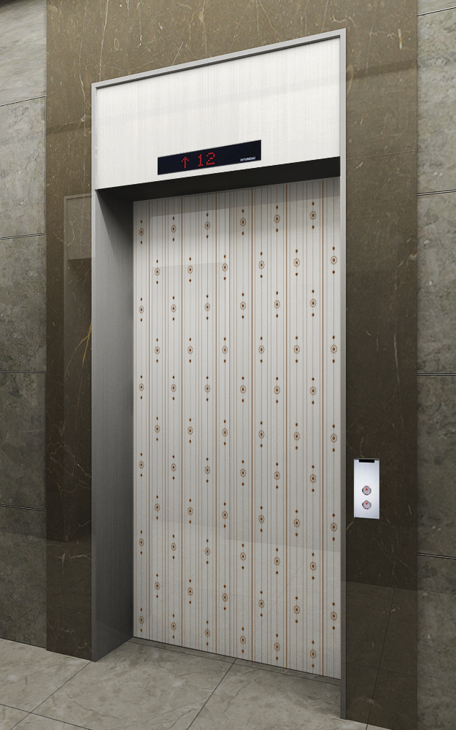
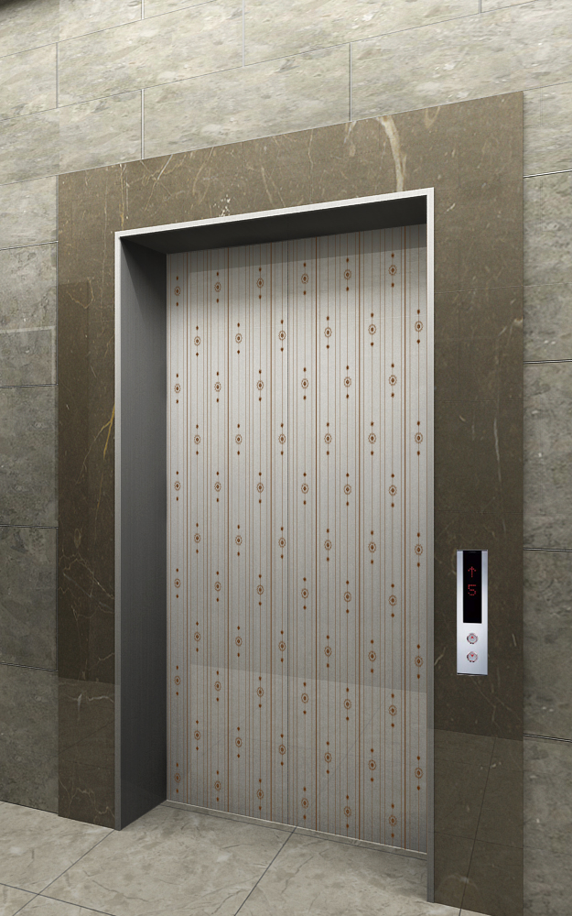
NEO SHINE METAL Elevator Interior Design
ALT-9
MAIN ENTRANCE
OTHER ENTRANCE
Front View
Rear View
2.
1.
CEILING
DOOR
WALL
HANDRAIL
FLOORING
INDICATOR
OPB
COLUMN & 상판
ELC2-014
Neo Shine Metal(CL/ 804)
Neo Shine Metal(CL/ 804, BZ/804)
1B
Deco Tile
PI-D110
OPP-N241B
STS Hairline
MAIN DOOR
막판
삼방틀
INDICATOR
HALL BUTTON
OTHER DOOR
막판
삼방틀
HALL BUTTON
Neo Shine Metal(CL/804)
STS Hairline
STS Hairline(200Type)
PI-D110(DOT TYPE)
HPB-841(노출형)
Neo Shine Metal(CL// 804)
STS Hairline
STS Hairline(100Type)
HIP-D841(노출형)
1. Neo Shine Metal(CL/ 804)
2. Neo Shine Metal(BZ/804, CL/804)

Slide 10
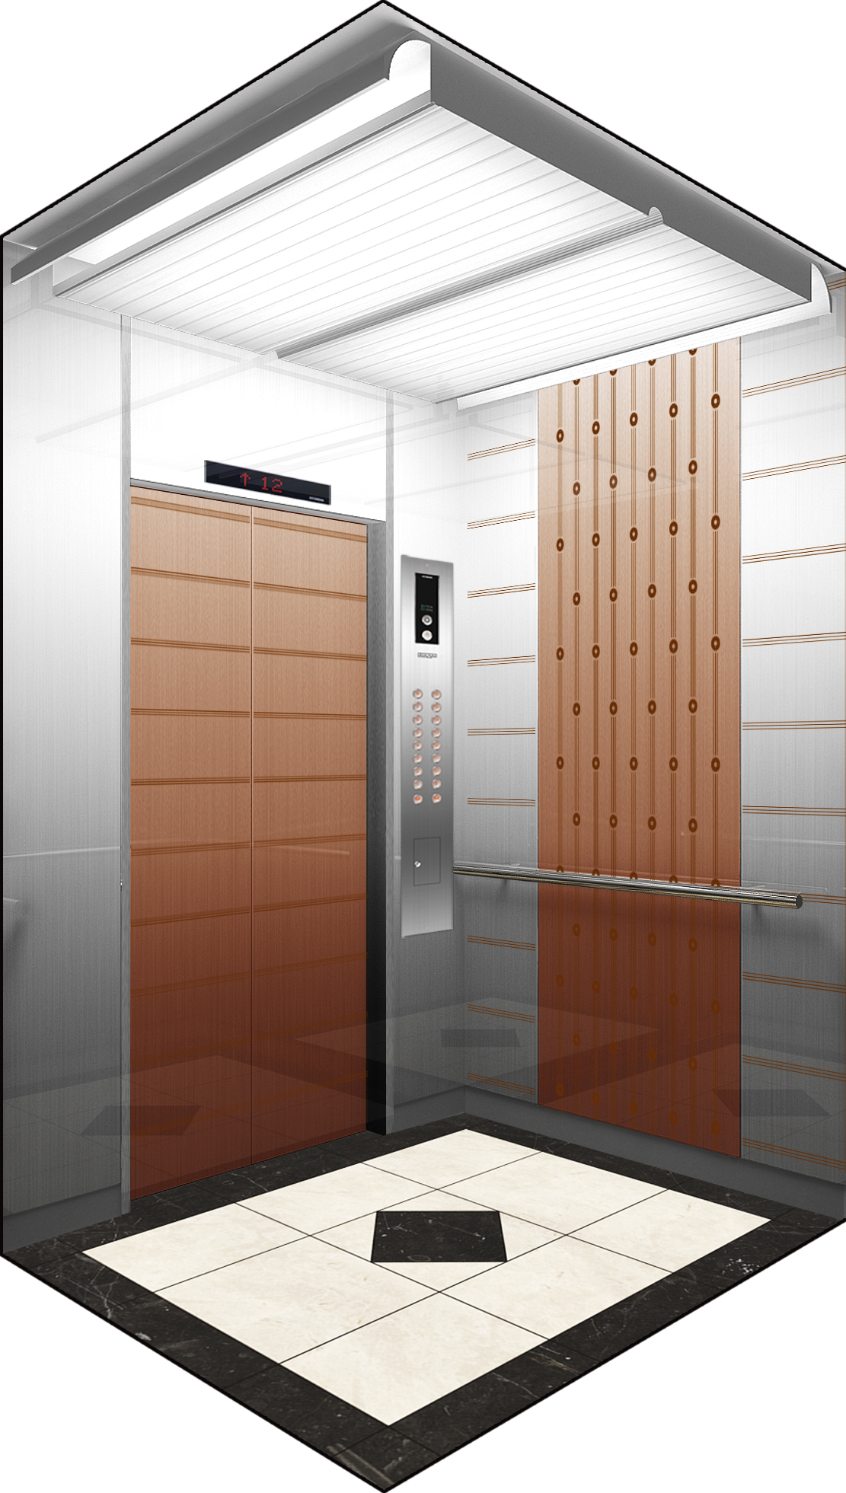
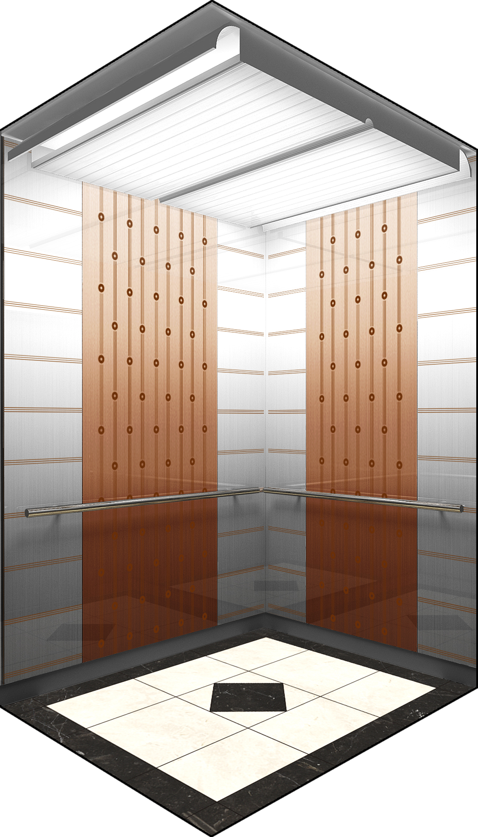
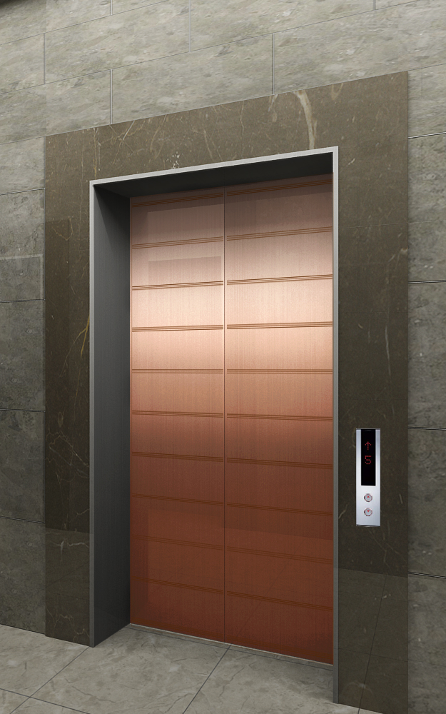
NEO SHINE METAL Elevator Interior Design
ALT-1 0
MAIN ENTRANCE
OTHER ENTRANCE
Front View
Rear View
2.
1.
CEILING
DOOR
WALL
HANDRAIL
FLOORING
INDICATOR
OPB
COLUMN & 상판
ELC2-014
Neo Shine Metal(BZ/ 804)
Neo Shine Metal(BZ/ 804, CL/804)
1B
Deco Tile
PI-D110
OPP-N241B
STS Hairline
MAIN DOOR
막판
삼방틀
INDICATOR
HALL BUTTON
OTHER DOOR
막판
삼방틀
HALL BUTTON
Neo Shine Metal(BZ/ 804)
STS Hairline
STS Hairline(200Type)
PI-D110(DOT TYPE)
HPB-841(노출형)
Neo Shine Metal(BZ/ 804)
STS Hairline
STS Hairline(100Type)
HIP-D841(노출형)
1. Neo Shine Metal(BZ/ 804)
2. Neo Shine Metal(CL/804, BZ/804)

Slide 11
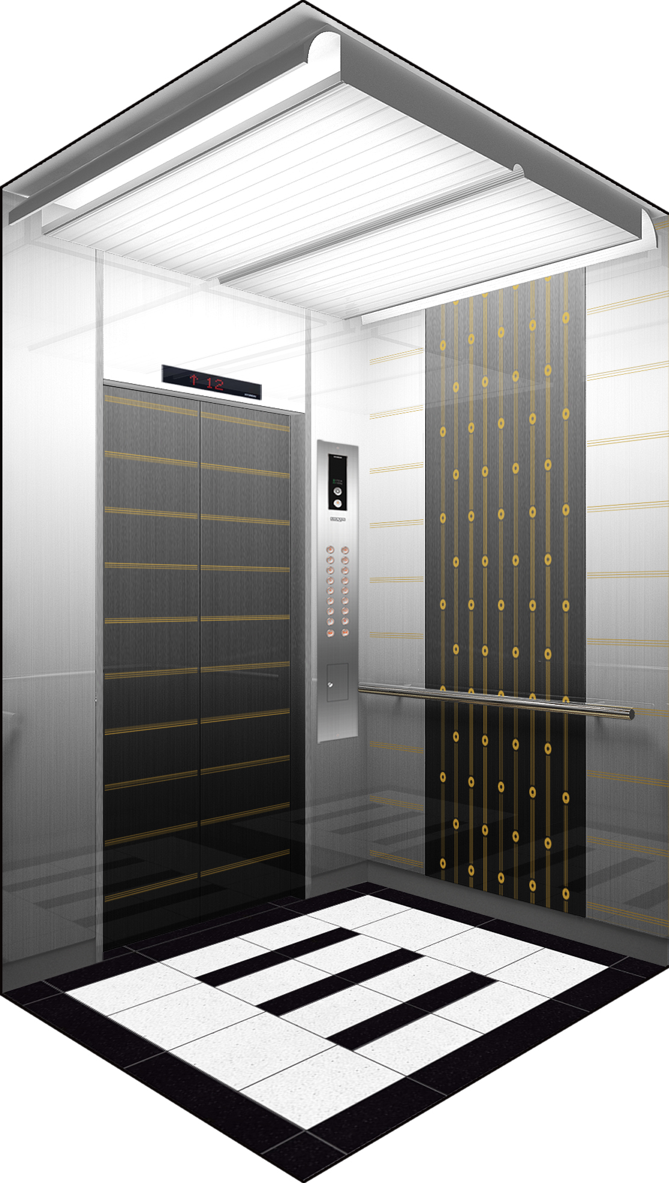
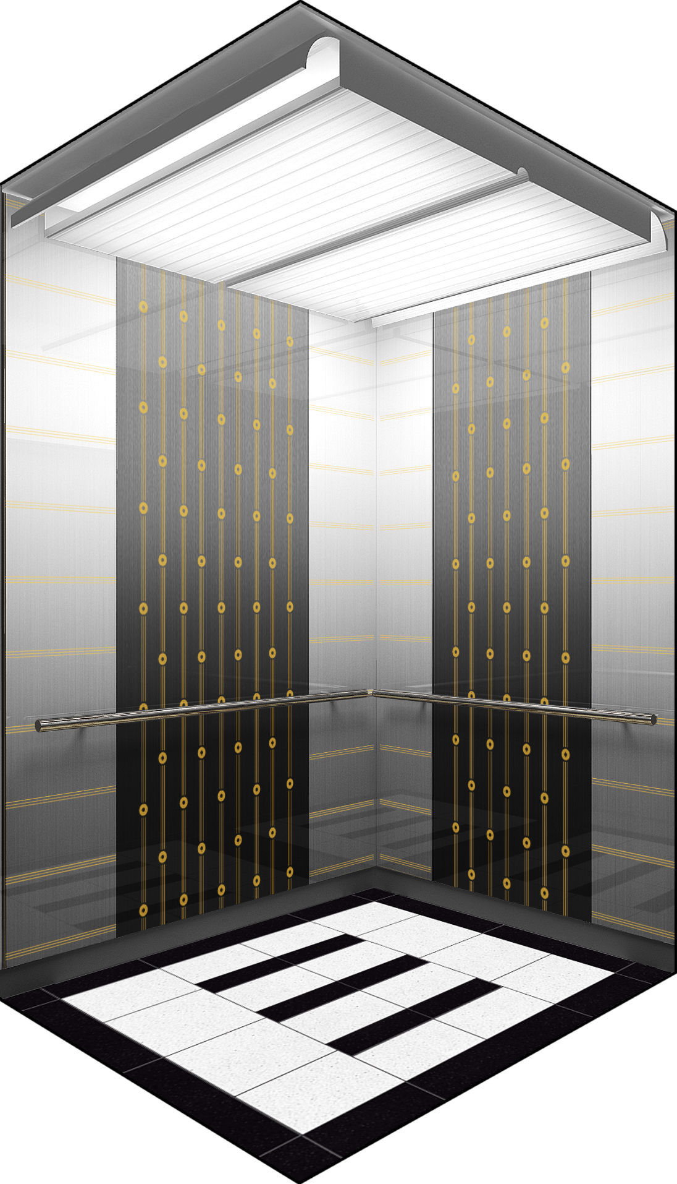
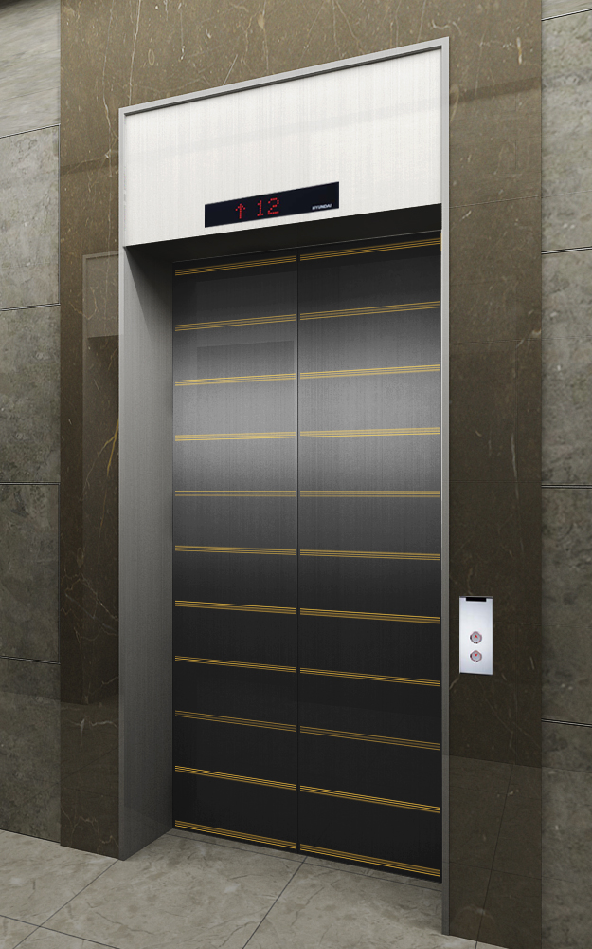
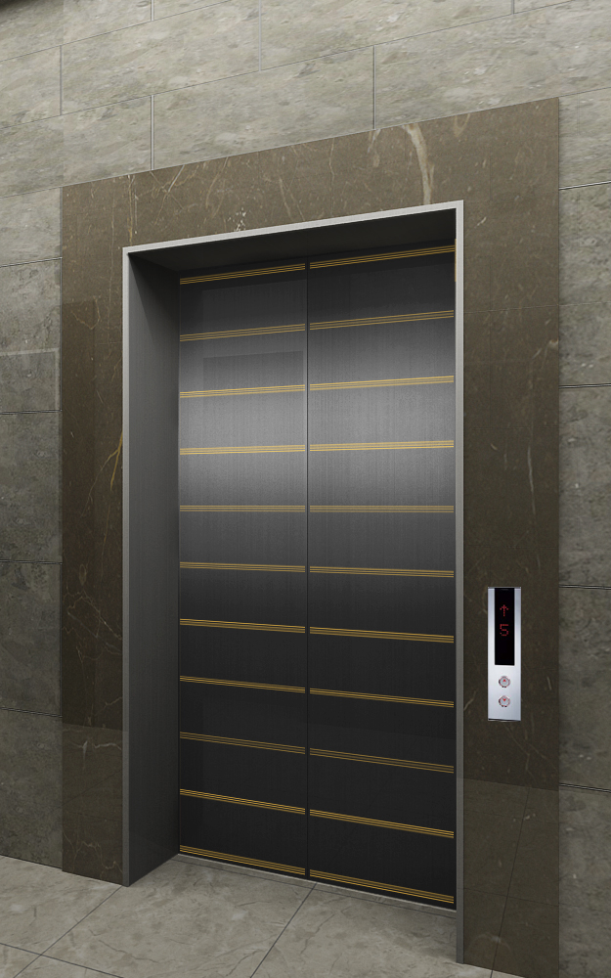
NEO SHINE METAL Elevator Interior Design
ALT-1 1
MAIN ENTRANCE
OTHER ENTRANCE
Front View
Rear View
2.
1.
CEILING
DOOR
WALL
HANDRAIL
FLOORING
INDICATOR
OPB
COLUMN & 상판
ELC2-014
Neo Shine Metal(BK/ 830)
Neo Shine Metal(BK/ 830, CL/830)
1B
Deco Tile
PI-D110
OPP-N241B
STS Hairline
MAIN DOOR
막판
삼방틀
INDICATOR
HALL BUTTON
OTHER DOOR
막판
삼방틀
HALL BUTTON
Neo Shine Metal(BK/ 830)
STS Hairline
STS Hairline(200Type)
PI-D110(DOT TYPE)
HPB-841(노출형)
Neo Shine Metal(BK/ 830)
STS Hairline
STS Hairline(100Type)
HIP-D841(노출형)
1. Neo Shine Metal(BK/ 830)
2. Neo Shine Metal(CL/830, BK/830)

Slide 12
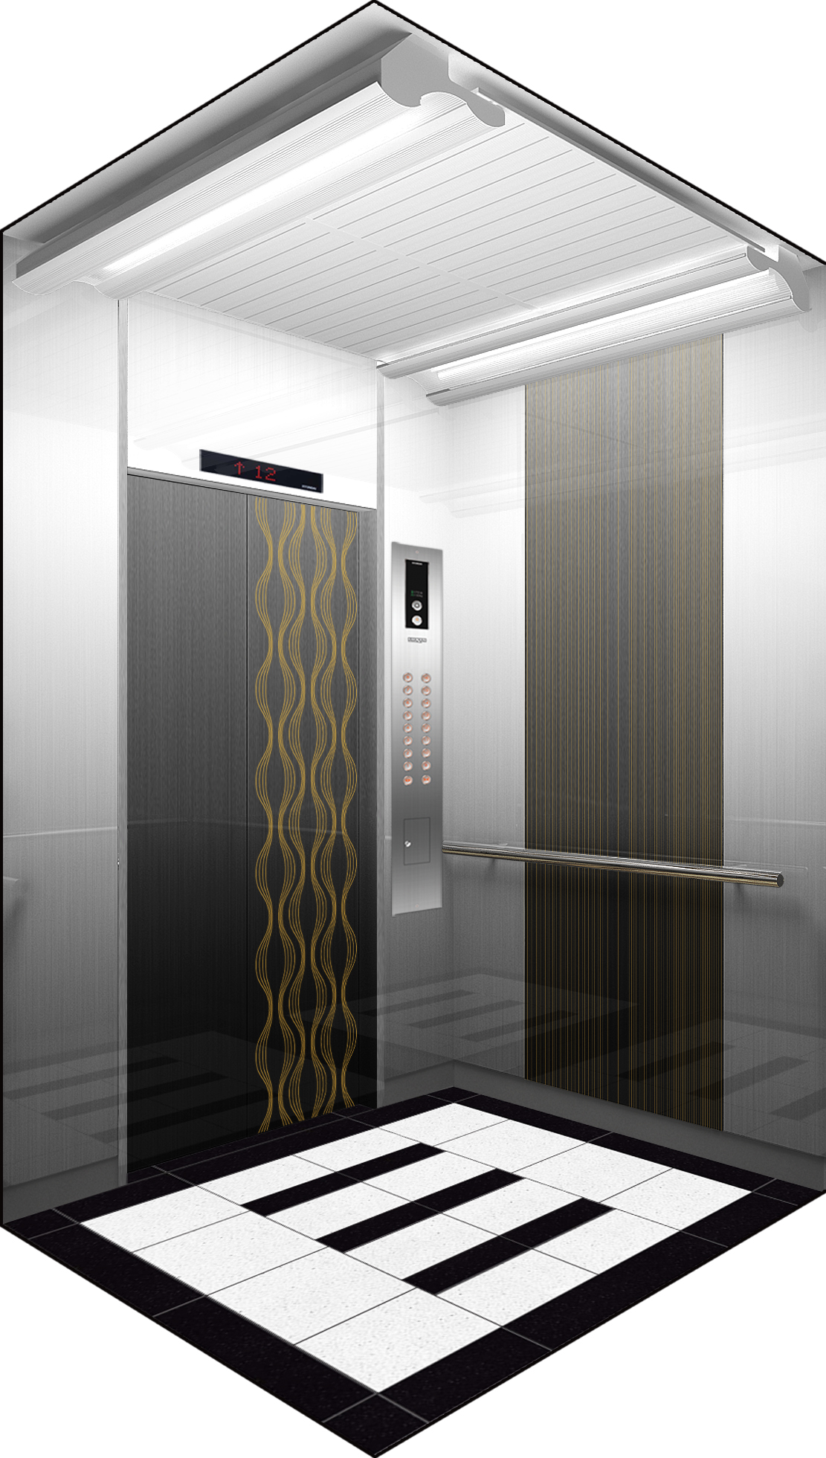
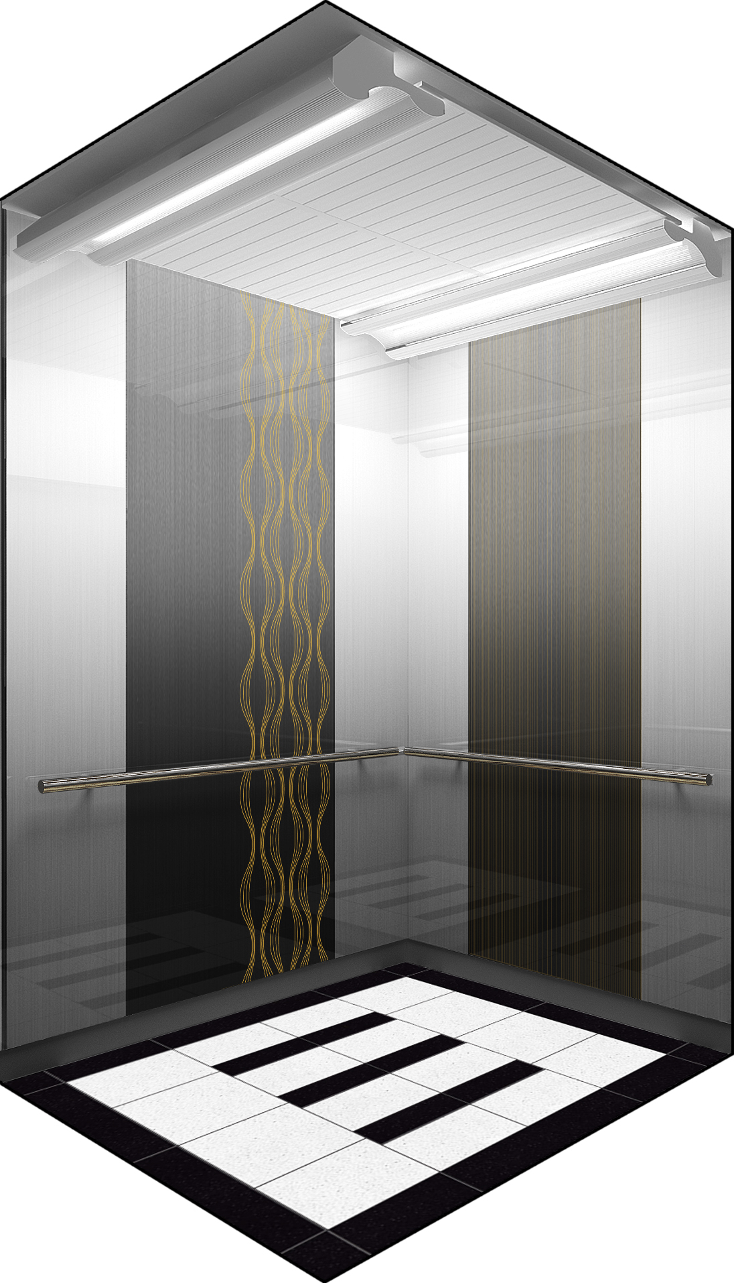
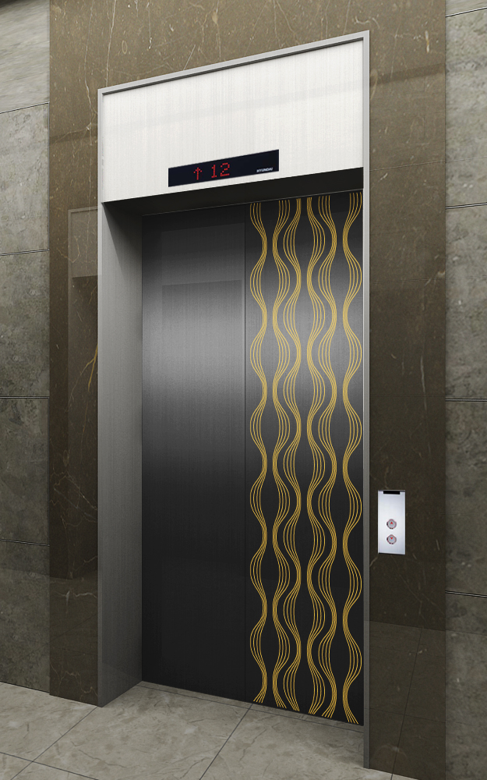
NEO SHINE METAL Elevator Interior Design
ALT-12
MAIN ENTRANCE
OTHER ENTRANCE
Front View
Rear View
2.
1.
CEILING
DOOR
WALL
HANDRAIL
FLOORING
INDICATOR
OPB
COLUMN & 상판
ELC2-012
Neo Shine Metal(BK/ 830)
Neo Shine Metal(BK/ 830, CL)
1B
Deco Tile
PI-D110
OPP-N241B
STS Hairline
MAIN DOOR
막판
삼방틀
INDICATOR
HALL BUTTON
OTHER DOOR
막판
삼방틀
HALL BUTTON
Neo Shine Metal(BK/830)
STS Hairline
STS Hairline(200Type)
PI-D110(DOT TYPE)
HPB-841(노출형)
Neo Shine Metal(BK/830)
STS Hairline
STS Hairline(100Type)
HIP-D841(노출형)
1. Neo Shine Metal(BK/830)
2. Neo Shine Metal(BK/830)

Slide 13
NEO SHINE METAL Elevator Interior Design
ALT-13
MAIN ENTRANCE
OTHER ENTRANCE
Front View
Rear View
2.
1.
CEILING
DOOR
WALL
HANDRAIL
FLOORING
INDICATOR
OPB
COLUMN & 상판
ELC2-011
Neo Shine Metal(BZ/ 804)
Neo Shine Metal(BZ/ 804, BK/804)
1B
인조 대리석
PI-D110
OPP-N241B
STS Hairline
MAIN DOOR
막판
삼방틀
INDICATOR
HALL BUTTON
OTHER DOOR
막판
삼방틀
HALL BUTTON
Neo Shine Metal(BZ/ 804)
STS Hairline
STS Hairline(200Type)
PI-D110(DOT TYPE)
HPB-841(노출형)
Neo Shine Metal(BZ/ 804
STS Hairline
STS Hairline(100Type)
HIP-D841(노출형)
1. Neo Shine Metal(BZ/804)
2. Neo Shine Metal(BK/804)

Slide 14
NEO SHINE METAL Elevator Interior Design
ALT-14
MAIN ENTRANCE
OTHER ENTRANCE
Front View
Rear View
2.
1.
CEILING
DOOR
WALL
HANDRAIL
FLOORING
INDICATOR
OPB
COLUMN & 상판
ELC2-011
Neo Shine Metal(CL/ 804)
Neo Shine Metal(CL/804, BZ/804)
1B
인조 대리석
PI-D110
OPP-N241B
STS Hairline
MAIN DOOR
막판
삼방틀
INDICATOR
HALL BUTTON
OTHER DOOR
막판
삼방틀
HALL BUTTON
Neo Shine Metal(CL/804)
STS Hairline
STS Hairline(200Type)
PI-D110(DOT TYPE)
HPB-841(노출형)
Neo Shine Metal(CL/ 804)
STS Hairline
STS Hairline(100Type)
HIP-D841(노출형)
1. Neo Shine Metal(CL/804)
2. Neo Shine Metal(BZ/804)

Slide 15
NEO SHINE METAL Elevator Interior Design
ALT-15
MAIN ENTRANCE
OTHER ENTRANCE
Front View
Rear View
2.
1.
CEILING
DOOR
WALL
HANDRAIL
FLOORING
INDICATOR
OPB
COLUMN & 상판
ELC2-012
Neo Shine Metal(CL/ 830)
Neo Shine Metal(CL/830, GD/830)
1B
Deco Tile
PI-D110
OPP-N241B
STS Hairline
MAIN DOOR
막판
삼방틀
INDICATOR
HALL BUTTON
OTHER DOOR
막판
삼방틀
HALL BUTTON
Neo Shine Metal(CL/830))
STS Hairline
STS Hairline(200Type)
PI-D110(DOT TYPE)
HPB-841(노출형)
Neo Shine Metal(CL/830)
STS Hairline
STS Hairline(100Type)
HIP-D841(노출형)
1. Neo Shine Metal(CL/830)
2. Neo Shine Metal(GD/830)

Slide 16
NEO SHINE METAL Elevator Interior Design
ALT-16
MAIN ENTRANCE
OTHER ENTRANCE
Front View
Rear View
1.
CEILING
DOOR
WALL
HANDRAIL
FLOORING
INDICATOR
OPB
COLUMN & 상판
ELC2-014
Neo Shine Metal(CL/ 824)
Neo Shine Metal(CL/824,BK/830)
1B
Deco Tile
PI-D110
OPP-N241B
STS Hairline
MAIN DOOR
막판
삼방틀
INDICATOR
HALL BUTTON
OTHER DOOR
막판
삼방틀
HALL BUTTON
Neo Shine Metal(CL/824)
STS Hairline
STS Hairline(200Type)
PI-D110(DOT TYPE)
HPB-841(노출형)
Neo Shine Metal(CL/824)
STS Hairline
STS Hairline(100Type)
HIP-D841(노출형)
1. Neo Shine Metal(CL/824)
2. Neo Shine Metal(BK/830)

Slide 17
NEO SHINE METAL Elevator Interior Design
ALT-17
MAIN ENTRANCE
OTHER ENTRANCE
Front View
Rear View
1.
CEILING
DOOR
WALL
HANDRAIL
FLOORING
INDICATOR
OPB
COLUMN & 상판
ELC2-014
Neo Shine Metal(BZ/804)
Neo Shine Metal(BZ/804, GD/804)
1B
인조 대리석
PI-D110
OPP-N241B
STS Hairline
MAIN DOOR
막판
삼방틀
INDICATOR
HALL BUTTON
OTHER DOOR
막판
삼방틀
HALL BUTTON
Neo Shine Metal(BZ/804)
STS Hairline
STS Hairline(200Type)
PI-D110(DOT TYPE)
HPB-841(노출형)
Neo Shine Metal(BZ/804)
STS Hairline
STS Hairline(100Type)
HIP-D841(노출형)
1. Neo Shine Metal(BZ/ 804)
2. Neo Shine Metal(GD/804)

Slide 18
NEO SHINE METAL Elevator Interior Design
ALT-18
MAIN ENTRANCE
OTHER ENTRANCE
Front View
Rear View
1.
CEILING
DOOR
WALL
HANDRAIL
FLOORING
INDICATOR
OPB
COLUMN & 상판
ELC2-014
Neo Shine Metal(GD/830)
Neo Shine Metal(GD/830.BZ/830))
1B
인조대리석
PI-D110
OPP-N241B
STS Hairline
MAIN DOOR
막판
삼방틀
INDICATOR
HALL BUTTON
OTHER DOOR
막판
삼방틀
HALL BUTTON
Neo Shine Metal(GD/830)
STS Hairline
STS Hairline(200Type)
PI-D110(DOT TYPE)
HPB-841(노출형)
Neo Shine Metal(GD/830)
STS Hairline
STS Hairline(100Type)
HIP-D841(노출형)
1. Neo Shine Metal(GD/830)
2. Neo Shine Metal(BZ/830)

